Slide 1
Bell Ringer: 05/09/18
POD numbers 3 -6 & 118-121

Slide 2
General Plant Information & Plant Adaptations
What structures help plants adapt to living on the land, and, hence, survive?

Slide 3
Characteristics of Plants
Eukaryotic
Multi-cellular
Autotrophic
Evolved from green algae
Make their own food through photosynthesis
Light + 6H₂O + 6CO₂ → C₆H₁₂O₆ + 6O₂
Occurs in organelles called chloroplasts

Slide 4
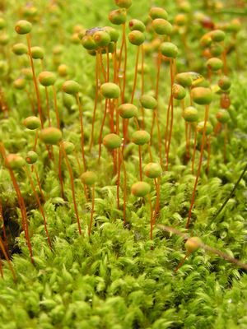
Nonvascular vs. Vascular
Nonvascular:
mosses & liverworts
Vascular:
- Ferns
Gymnosperms
Cone-bearing plants
Pine, cedar, redwood, fir, cypress, etc
Angiosperms
Flower-bearing plants

Slide 5
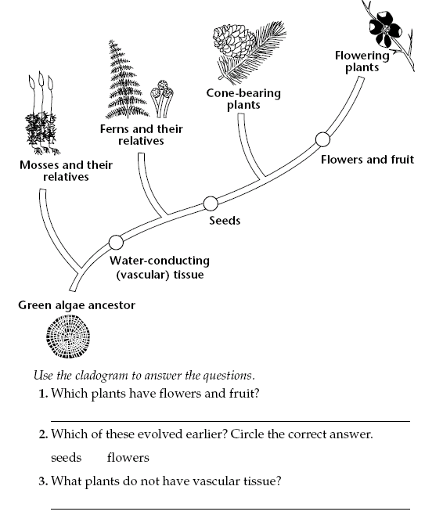
Cladogram of Plant Evolution
4. What plants have vascular tissue?
5. Which plants have
seeds?

Slide 6
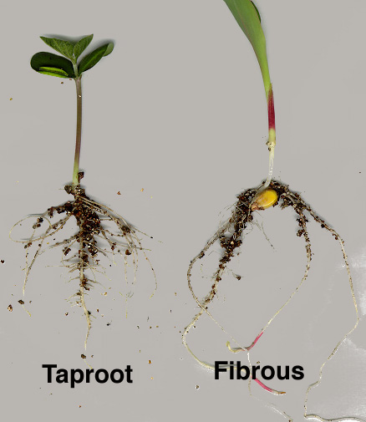
Plant Adaptation: ROOTS
Allows plants to take in
water needed for
photosynthesis while
living on land
Types of roots →

Slide 7
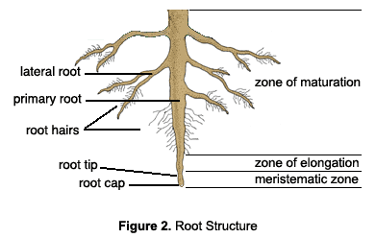
Plant Adaptation: ROOTS
Root Hairs – increase the surface area, so more water can be absorbed by plants

Slide 8
Plant Adaptation: XYLEM & PHLOEM
Xylem: tissue that transports water from the roots to the stem
Phloem: tissue that transport glucose (food) from the leaf to other areas of the plant’s body
Collectively called “vascular bundle”

Slide 9
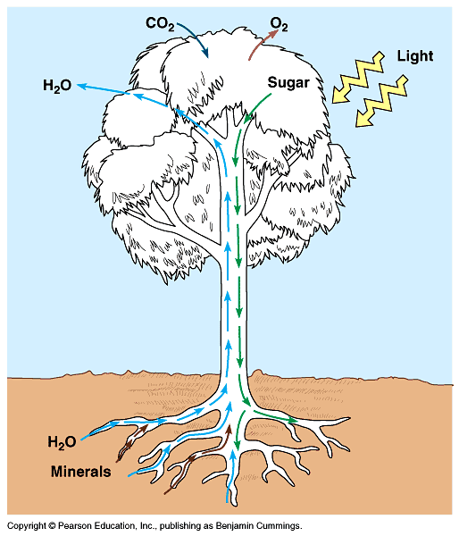

Slide 10
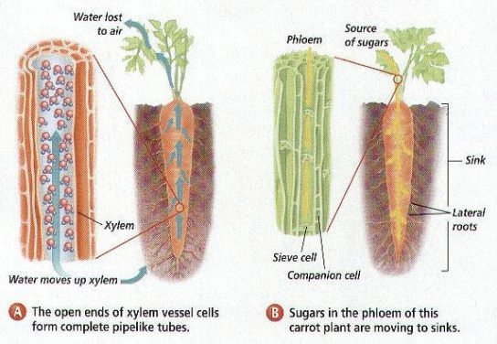
Plant Adaptation: Xylem & Phloem

Slide 11
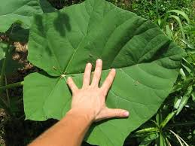
Plant Adaptation: LEAVES
Provides a large surface area to trap sunlight needed for photosynthesis

Slide 12
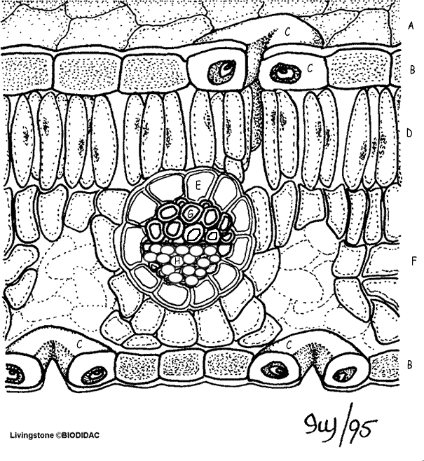
Plant Adaptation: LEAVES
Leaf Anatomy:
A: Cuticle (light blue) B: Epidermis (yellow) C: Guard cells (pink) D: Palisade Mesophyll (dark green) E: Bundle Sheath (dark blue) F: Spongy Mesophyll (light green) G: Xylem (orange) H: Phloem (dark purple)

Slide 13
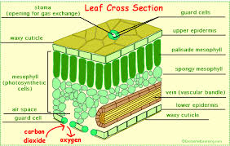
Structure of the Leaf
What are the parts of the leaf responsible for?
Write down one part of the leaf and what it is used for.
https://www.youtube.com/watch?v=co0JdqUlycg

Slide 14
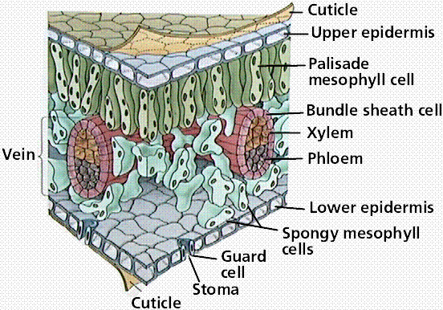
Plant Adaptation: CUTICLE
Waxy outer covering on a leaf or fruit
What does this
Covering help prevent?
(Hint: think about what
resource plants don’t
want to lose!)

Slide 15
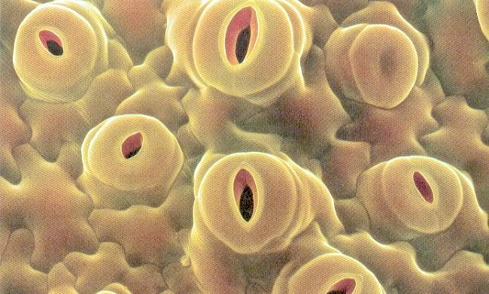
Plant Adaptation: STOMATA
Small openings on leaves, where CO₂ enters the plant AND where O₂ and H₂O leave the plant

Slide 16
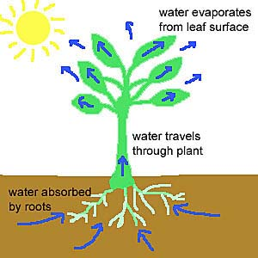
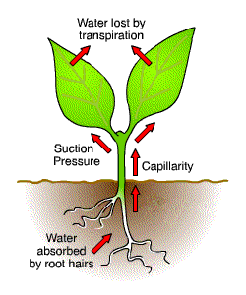
Plant Adaptation: STOMATA
Transpiration → process where H₂O leaves a plant

Slide 17
Spore Bearing vs. Seed Bearing Plants
Spore Bearing:
Mosses & liverworts
Ferns
Seed Bearing:
Gymnosperms
Cone-bearing plants
Angiosperms
Flower-bearing plants

Slide 18
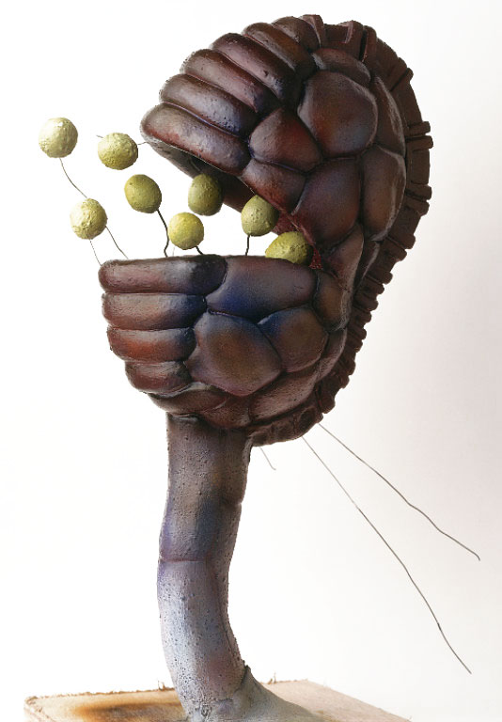
Plant Adaptation: SPORES
Light-weight & can be carried by wind
Capsule
Spore

Slide 19
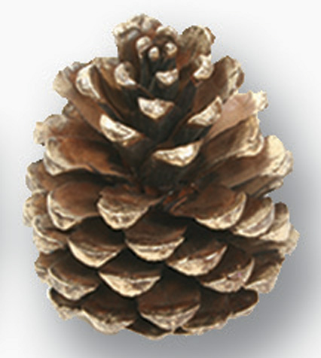
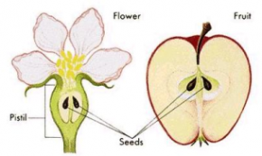
Plant Adaptation: SEED PLANTS
Gymnosperms use a
CONE to contain their
seeds.
Angiosperms use a
FRUIT/FLOWER to
contain their seeds.

Slide 20
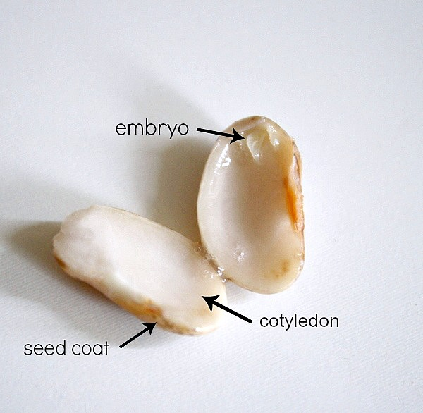
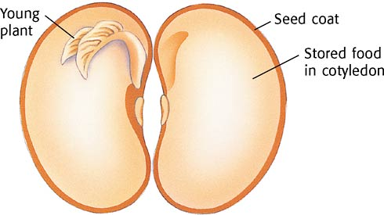
Plant Adaptation: SEEDS
After pollination, a seed is formed. The seed houses a “baby” plant and a food supply (endosperm) for the plant

Slide 21
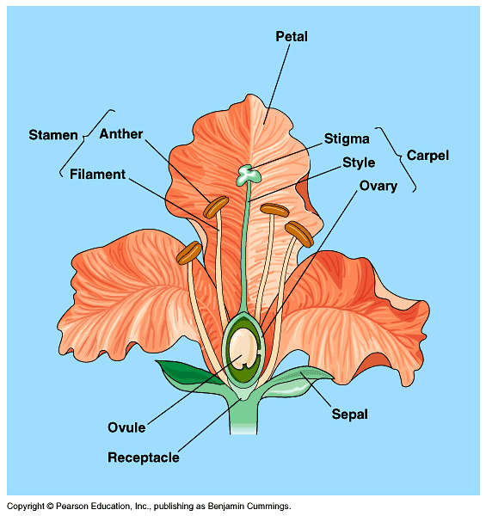
Plant Adaptation: FLOWERS
Reproductive structure
of angiosperms
(flowering plants)
Female: pistil/carpel
Style, stigma, and ovary
Male: stamen
Anther and filament

Slide 22
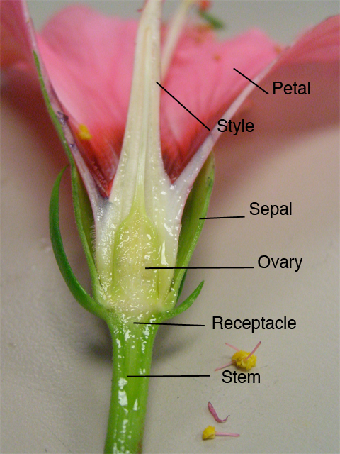
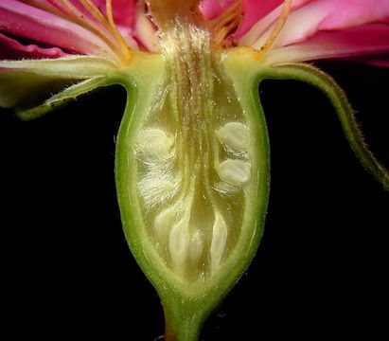
Plant Adaptation: FLOWERS
What reproductive cells
are found inside of the
ovary in the FEMALE
part of the plant?
(Hint: think about
What all FEMALE
reproductive cells
are called)
?

Slide 23
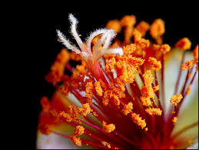
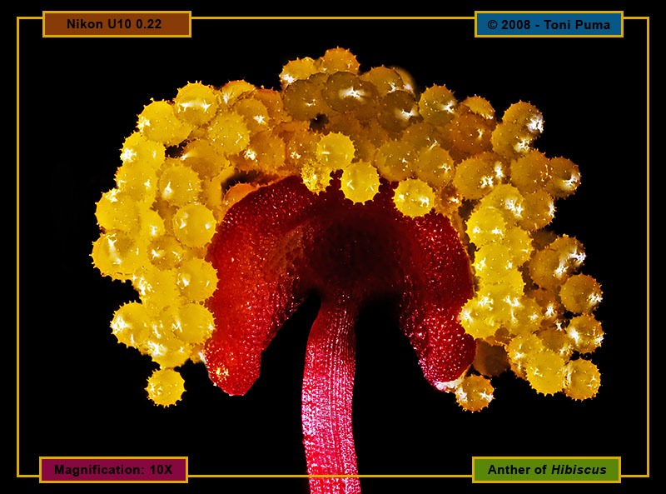
Plant Adaptation: FLOWERS
What reproductive cells
are found on the anther
in the MALE part of the plant?
?
?
Hint: What reproductive cells do all males have???

Slide 24
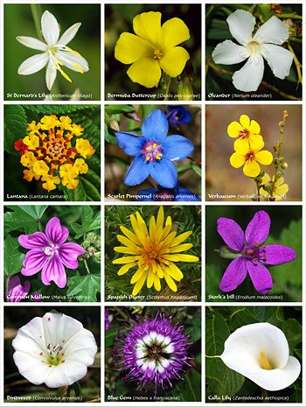
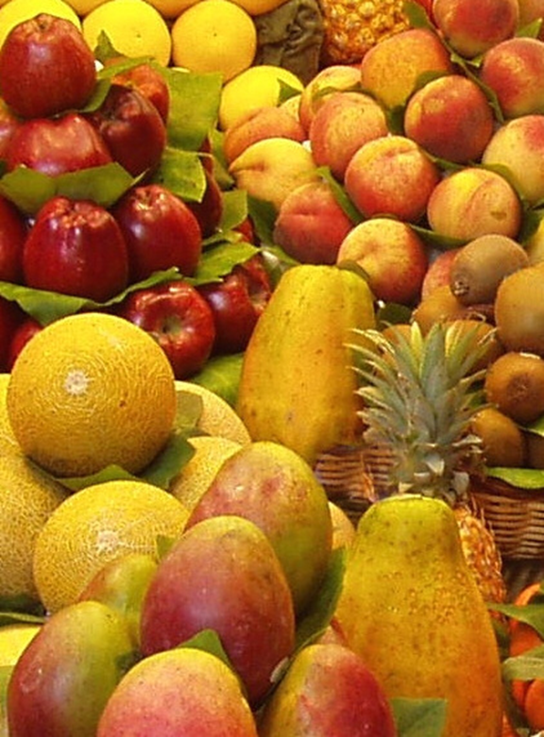
Plant Adaptation: Flowers & Fruit
What are the roles of flowers and fruit for a plant?

Slide 25
Plant Structures & Adaptations
Write down eight facts
https://www.youtube.com/watch?v=DGpPHrLF-5M

Slide 26
When finished raise hand then work on Get It 12-16

Slide 27
Closure POD #8

Slide 28
DEAR DAY
tinyurl.com/akrisingseniors

Slide 29
May 10th Living Org.
What is the function of nephridia?
Identify two organisms that respire through their skin.
Why are frogs able to complete external reproduction as compared to a land mammal?
Why are leaves on the jungle floor larger than the top?

Slide 30
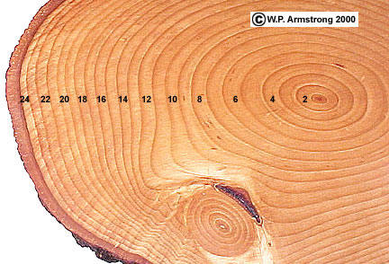
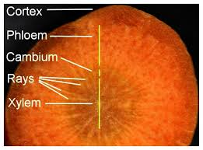
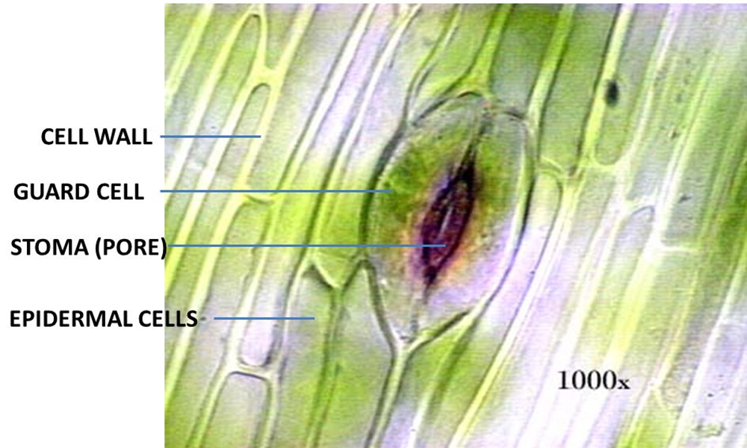
Microviewer Picture →

Slide 31
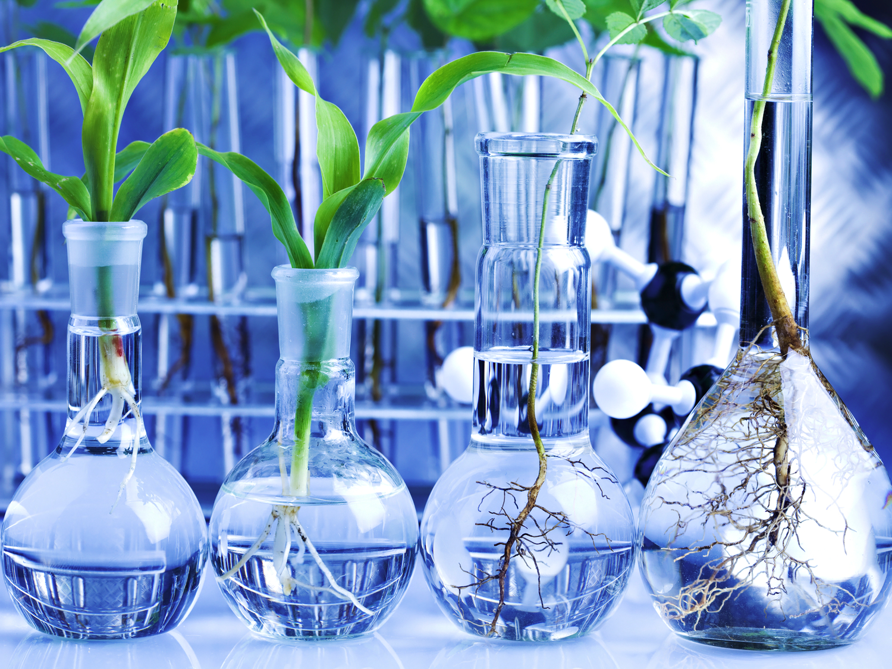
STERNGRR Plant Lab
How do we treat dissecting microscopes?
Show me the pollen and ovary under your dissecting scope to receive a check mark.
If you tare my plants you can go out into the wilderness and replace them…I only accept moss with spores. ☺
When finished clean up station and work on POD 122-127

Slide 32
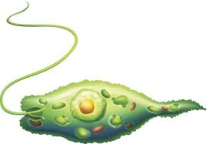
Closure
What is this and how does it move?

