Slide 1
What is Classification?
Classification is the arrangement of organisms into orderly groups based on their similarities
Classification is based on evolutionary relationships

Slide 2
What is Classification?
Classification is also known as taxonomy
Taxonomists are scientists that identify & name organisms

Slide 3
Benefits of Classifying
Accurately & uniformly name organisms
Prevent misnomers such as starfish & jellyfish that aren't really fish
Use the same language (Latin or some Greek) for all names

Slide 4
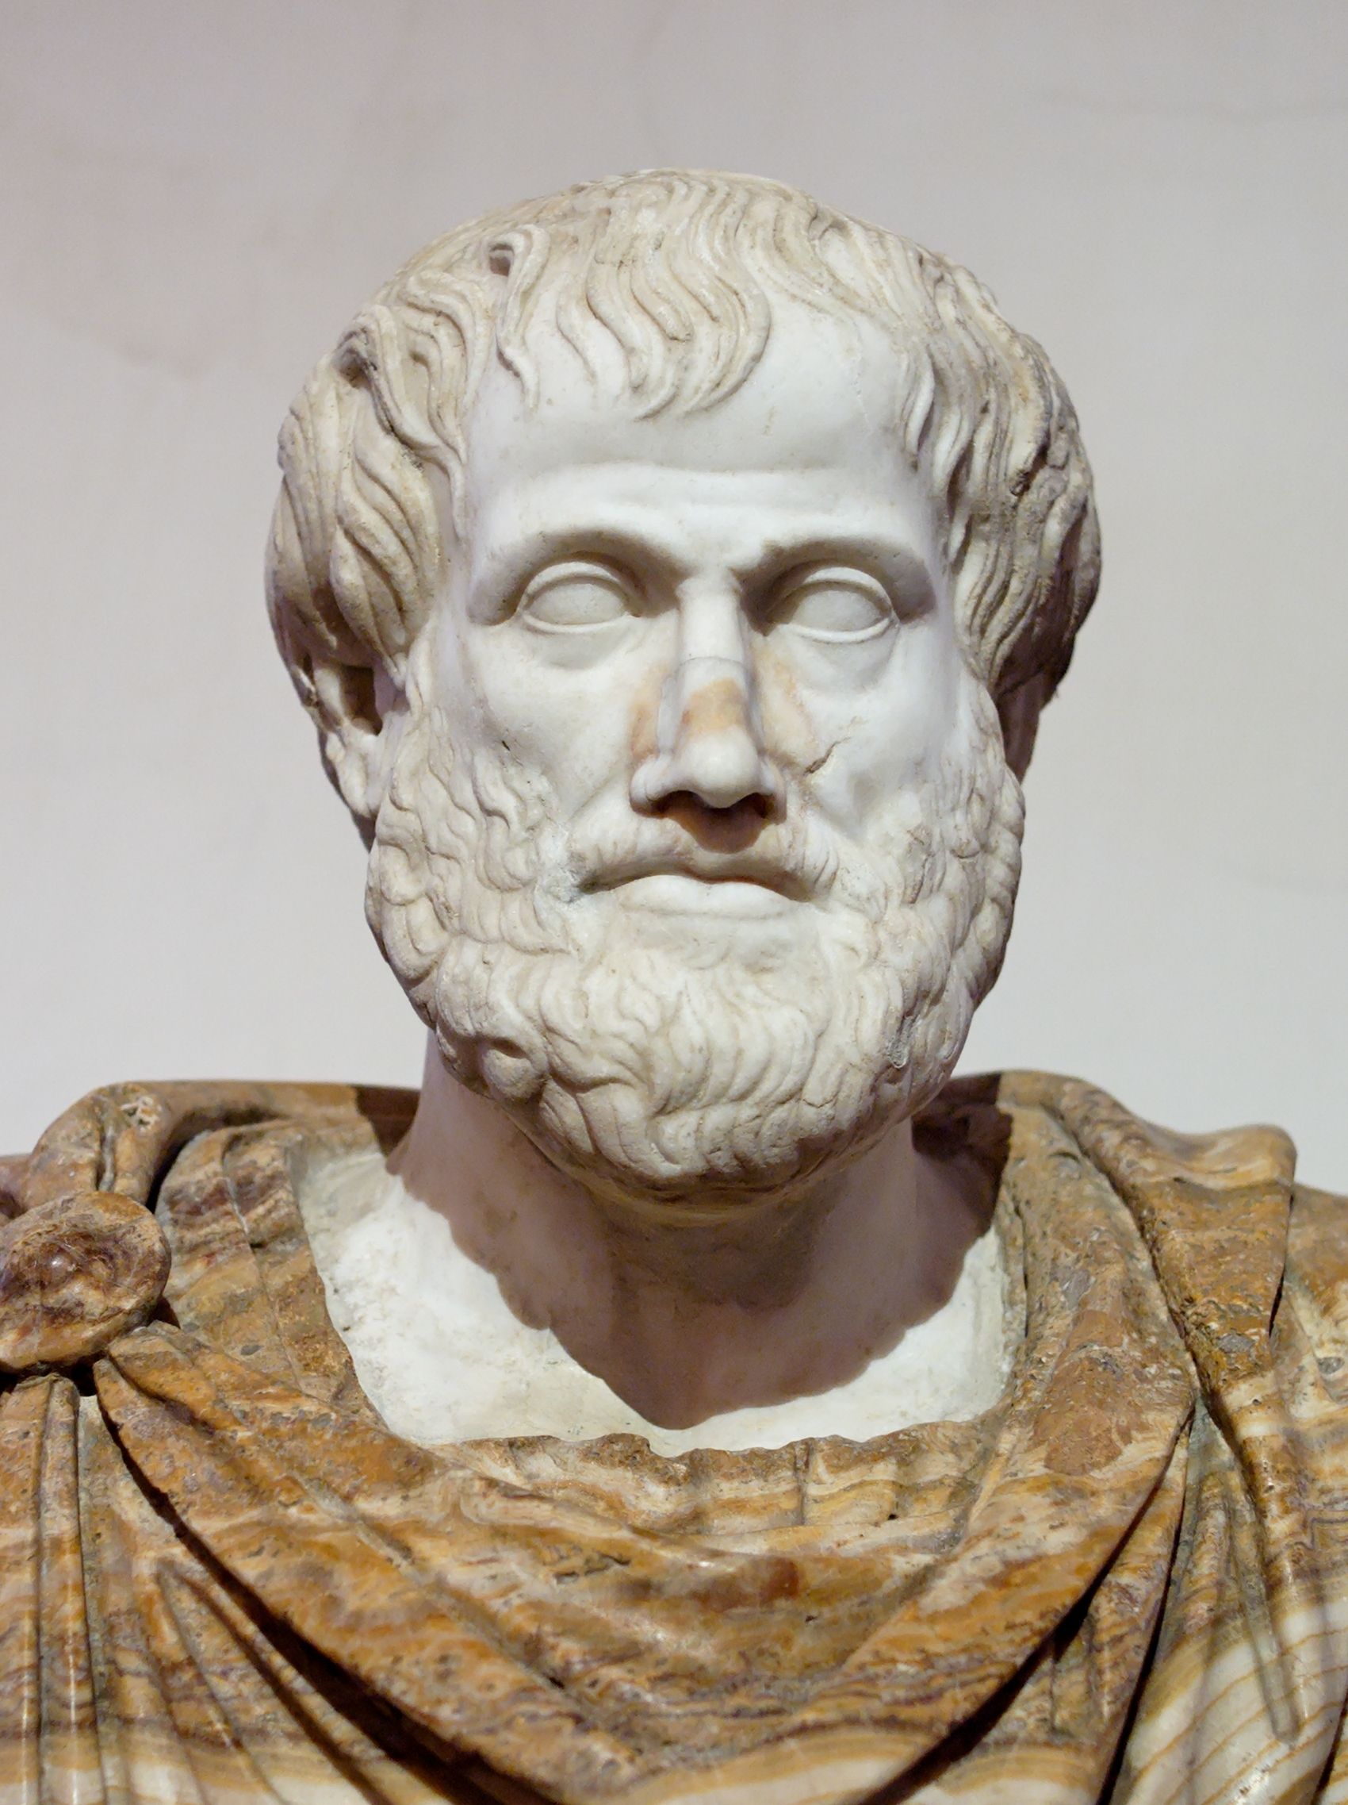
Early Taxonomists
2000 years ago, Aristotle was the first taxonomist
Aristotle divided organisms into plants & animals
He then subdivided those groups by habitat
→land, sea, or air dwellers

Slide 5
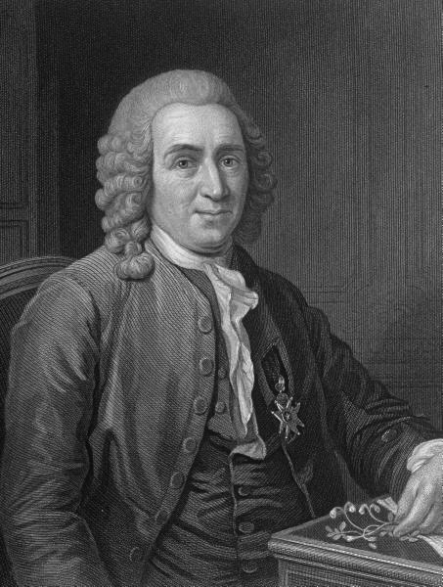
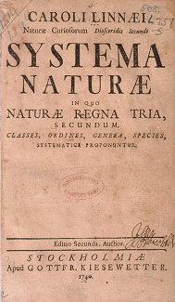
Carolus Linnaeus
18th century
Called the “Father of Taxonomy”
Classified organisms by their structure
Developed naming system still used today
3. Developed the 7 levels of classification

Slide 6
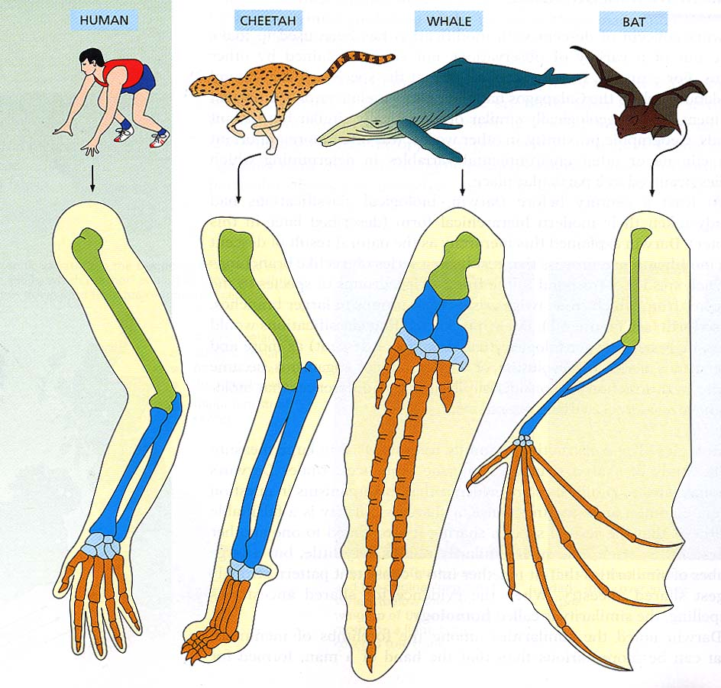
Basis for Modern Taxonomy
Homologous structures (same structure, different function)
Similar embryo development
Molecular Similarity in DNA, RNA, or amino acid sequence of proteins
Notes:
Ended here

Slide 7
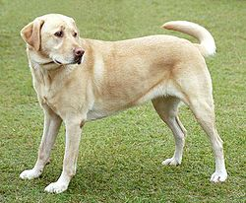
2. Binomial Nomenclature
The modern system of naming is known as binomial nomenclature
Utilizes a two-word scientific naming system (Genus & species)
Canis lupus

Slide 8
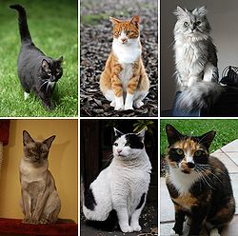
2. Binomial Nomenclature
Identifies organism by Genus and species
Latin or Greek words
Capitalize “Genus”, but NOT “species”
Underline when in writing
Italicized in print
Felis catus

Slide 9
Hierarchy of Taxonomic Groups
Domain
Kingdom
Phylum
Class
Order
Family
Genus
Species
Most BROAD
Most Specific
* Create your mnemonic for remembering the hierarchy of taxonomic groups.
Notes:
Create your own acronym to remember the order.

Slide 10
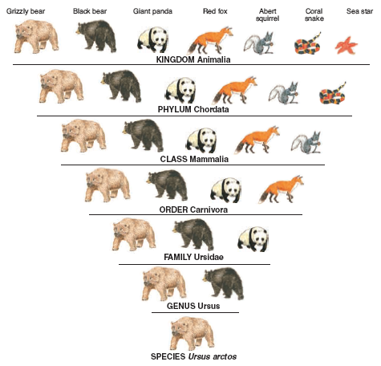
Do
Keep
Potty
Clean
Or
Family
Gets
Sick

