Slide 1
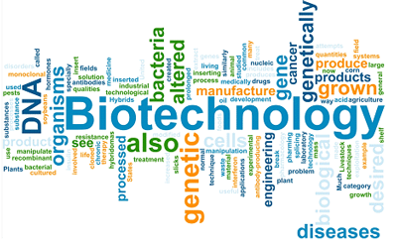

Slide 2
What is the relationship between
science and technology?
Science
Search for knowledge about ourselves and the physical world
Process: scientific method; looking for patterns in the physical world; evaluated by how well facts support conclusions; limited by ability to collect evidence
Discoveries give rise to technological advances
Technology
Practical application of knowledge; adapting ourselves to physical world
Process: finding solutions to problems; try to control physical world; evaluate by how well it works; limited by costs and available technology
Advances give rise to scientific discoveries

Slide 3
Some vocabulary you should know…
Biotechnology
Genetic engineering
Recombinant DNA technology
Restriction enzymes, PCR and Gel Electrophoresis
Expression vectors

Slide 4
Genetic Engineering
What is recombinant DNA?
DNA made of segments from more than one source.
Ex: bacteria that have the human gene for insulin
Method that cuts DNA from one organism and inserts it into another organism to create recombinant DNA
Also called Recombinant DNA Technology

Slide 5
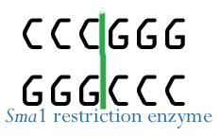
Restriction Enzymes Blunt Ends: Equal Cut

Slide 6
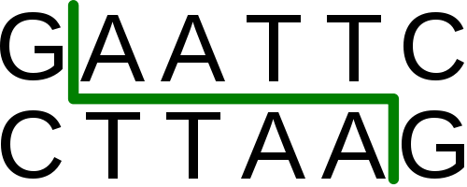
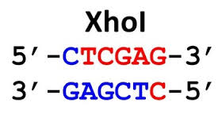
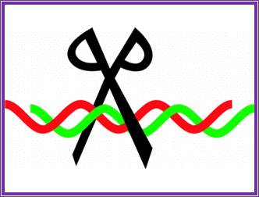
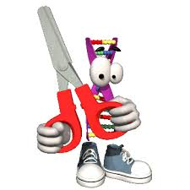
Restriction Enzymes Sticky Ends: Zig Zag Cut

Slide 7
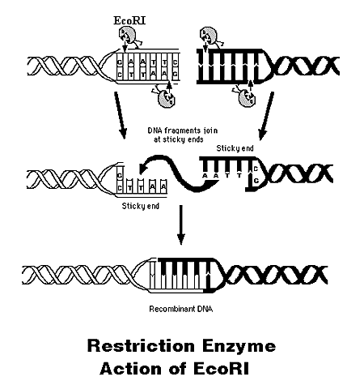
Genetic Engineering
Remember, we said that restriction enzymes can cut leaving blunt or sticky end…right?
This is why you would leave sticky ends.

Slide 8
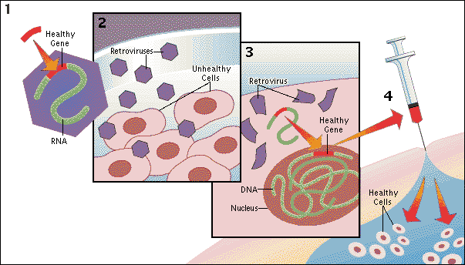
Genetic Engineering

Slide 9
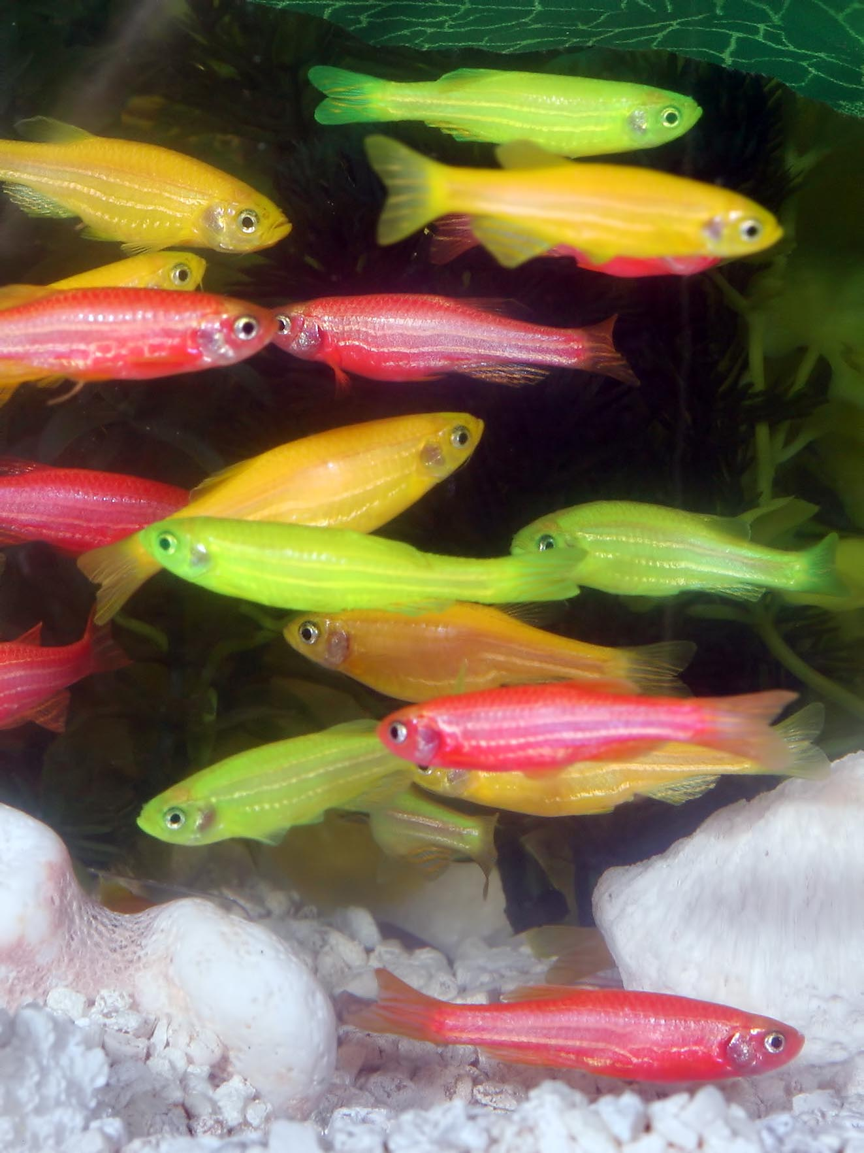
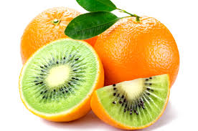
Genetic Engineering Continued
Uses of recombinant DNA technology…..
Making insulin for diabetics
Breaking down crude oil to order to clean up oil spills
Gene therapy
Genetically modified foods (called “Frankenfoods”)

Slide 10
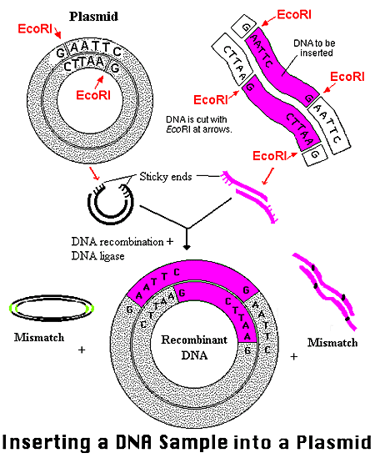
Genetic Engineering Continued
Plasmid: a small circular of bacterial DNA
Acts as a vector
Foreign DNA can be inserted into a plasmid
Recombinant plasmid is put back into bacteria & every time the bacteria divides, the plasmid is replicated, along with the foreign DNA

Slide 11
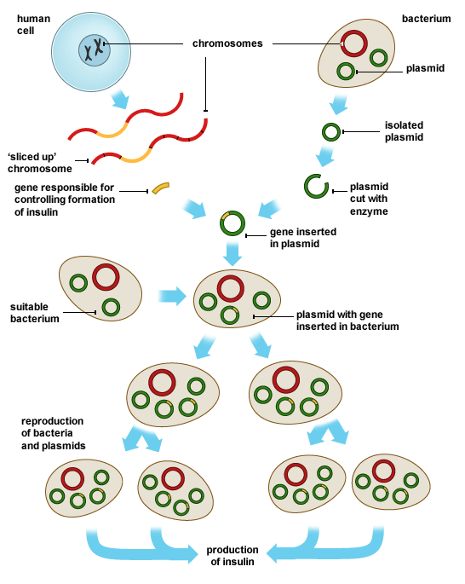
Steps in Genetic Engineering

Slide 12
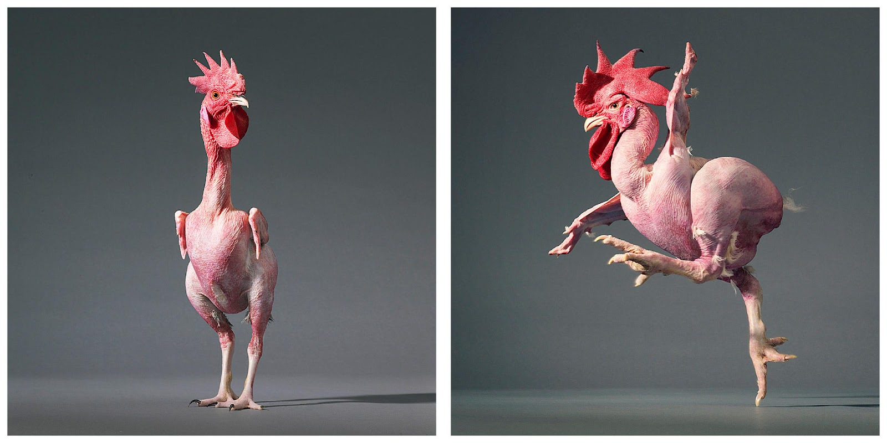
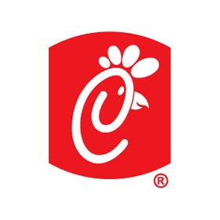
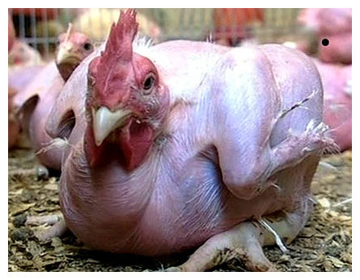
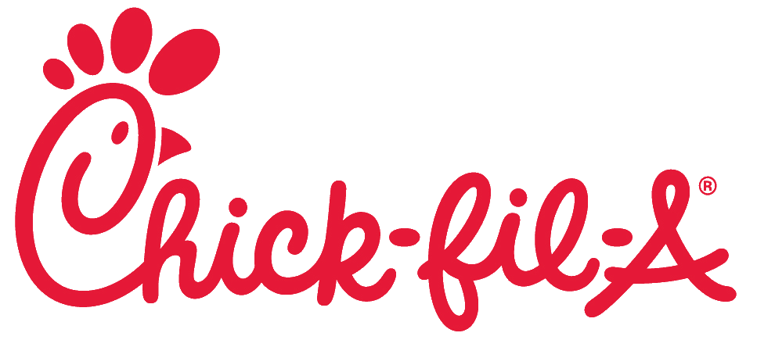
Chicken – Feathers = Dinosaur!
FF

Slide 13
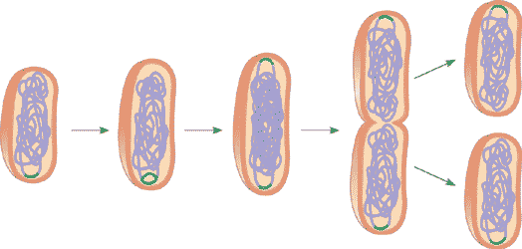
Advantages of working with microbes
They grow fast (even single-celled eukaryotes like yeast)
They don’t take up much space
They can be an economical source of genetically-engineered material
They have the same DNA as all living organisms

Slide 14
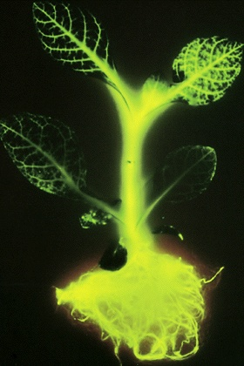
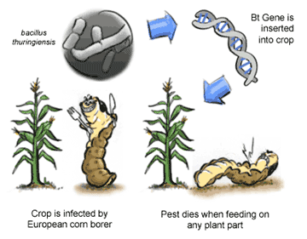
Transgenic organisms
A. What are transgenics?
Any organism that contains foreign DNA.
Ex. Tobacco plants that glow, bacteria that grow insulin, livestock that have extra growth hormones & grow leaner/faster, plants that produce a natural pesticide

Slide 15
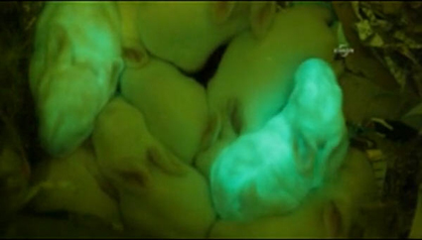
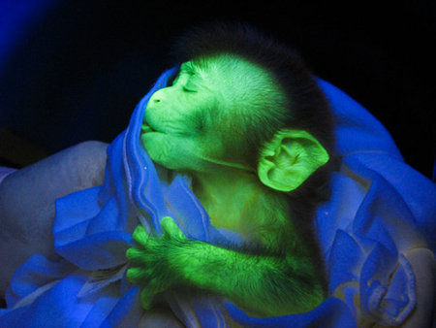
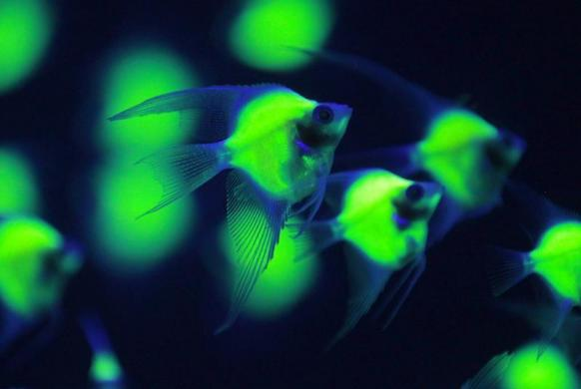
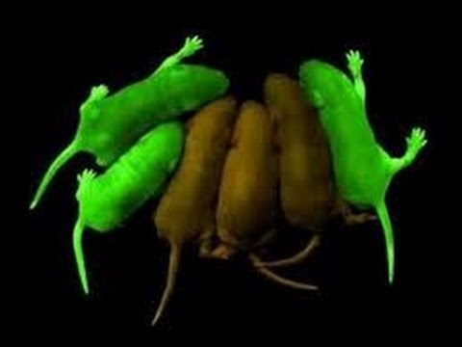
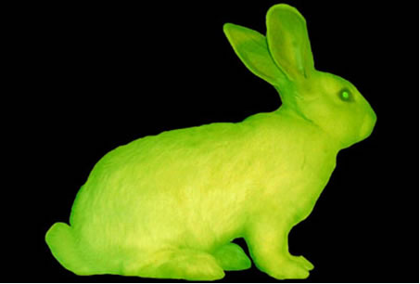
Transgenic Organisms

Slide 16
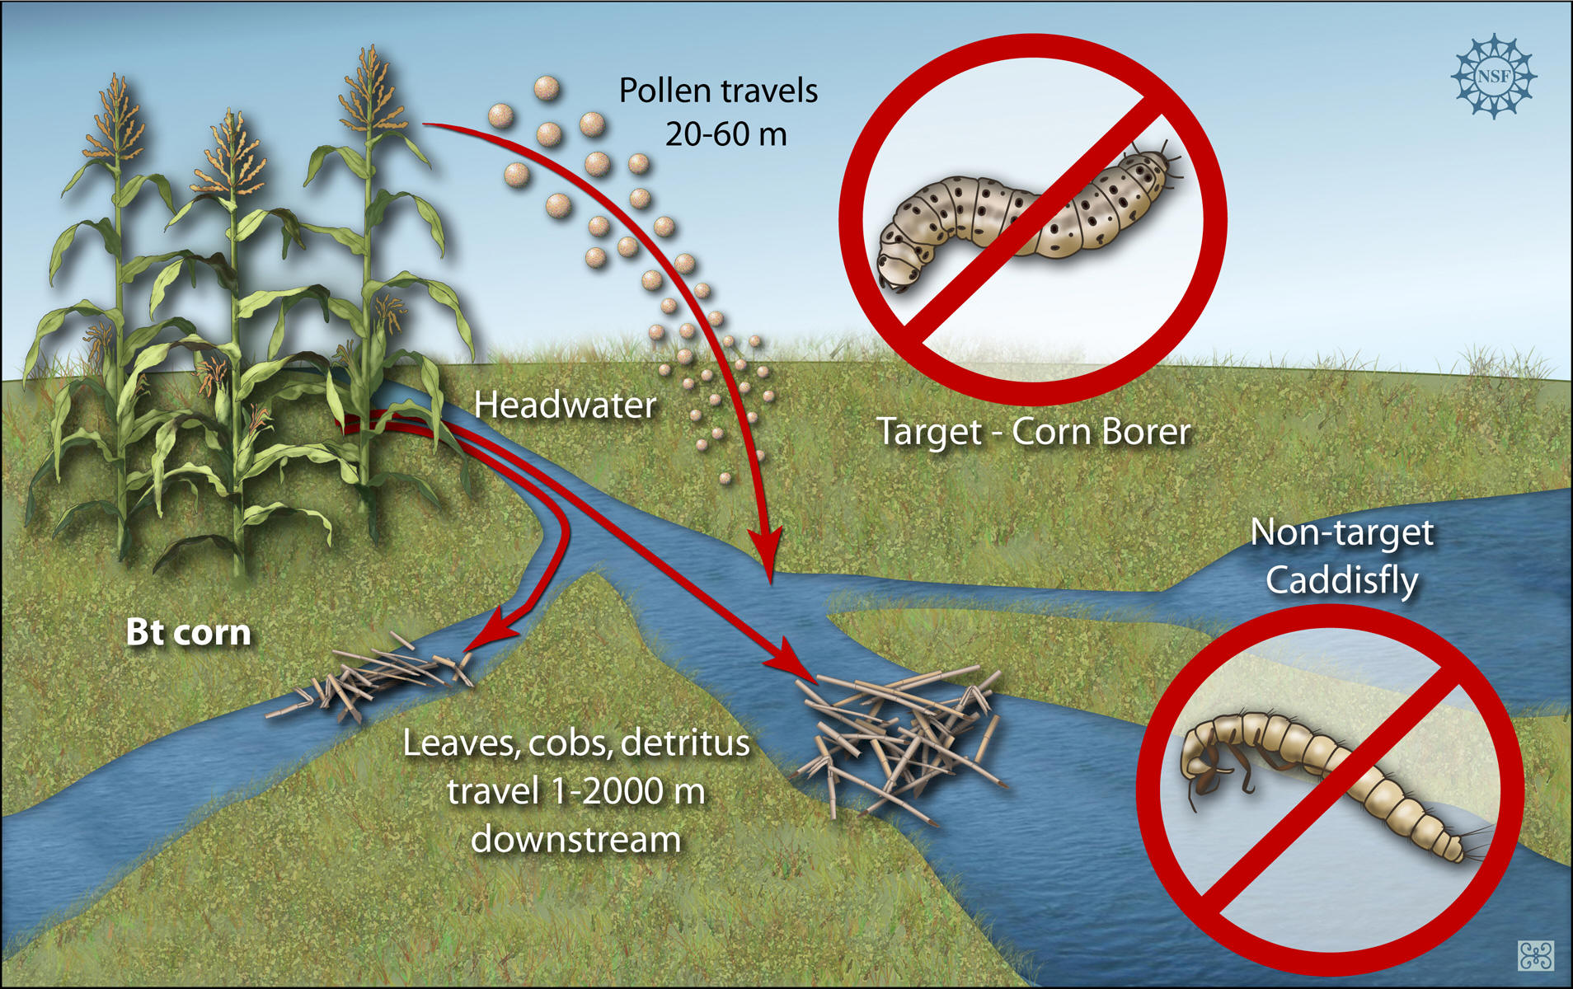
Transgenic organisms continued…
Are the opportunities associated with transgenics safe?

Slide 17
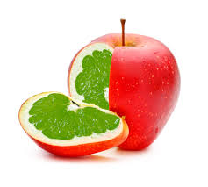
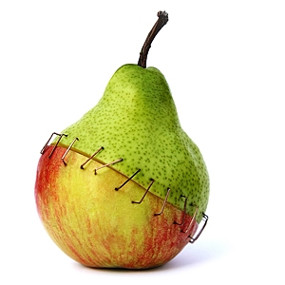
Genetically modified foods
A. Any food consumed that has been genetically altered, usually has recombinant DNA
B. Also called “Frankenfood”
C. By 2000, approximately 52% of soybeans and 25% of corn grown in the US was transgenic or genetically modified (Prentice Hall Biology, 2005, p. 332).

Slide 18
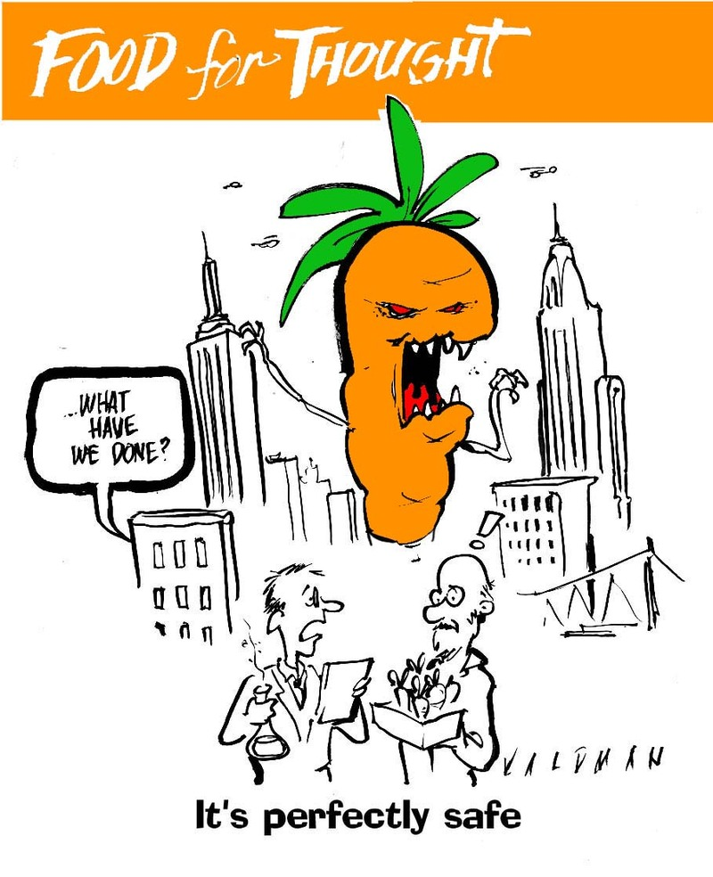

Slide 19
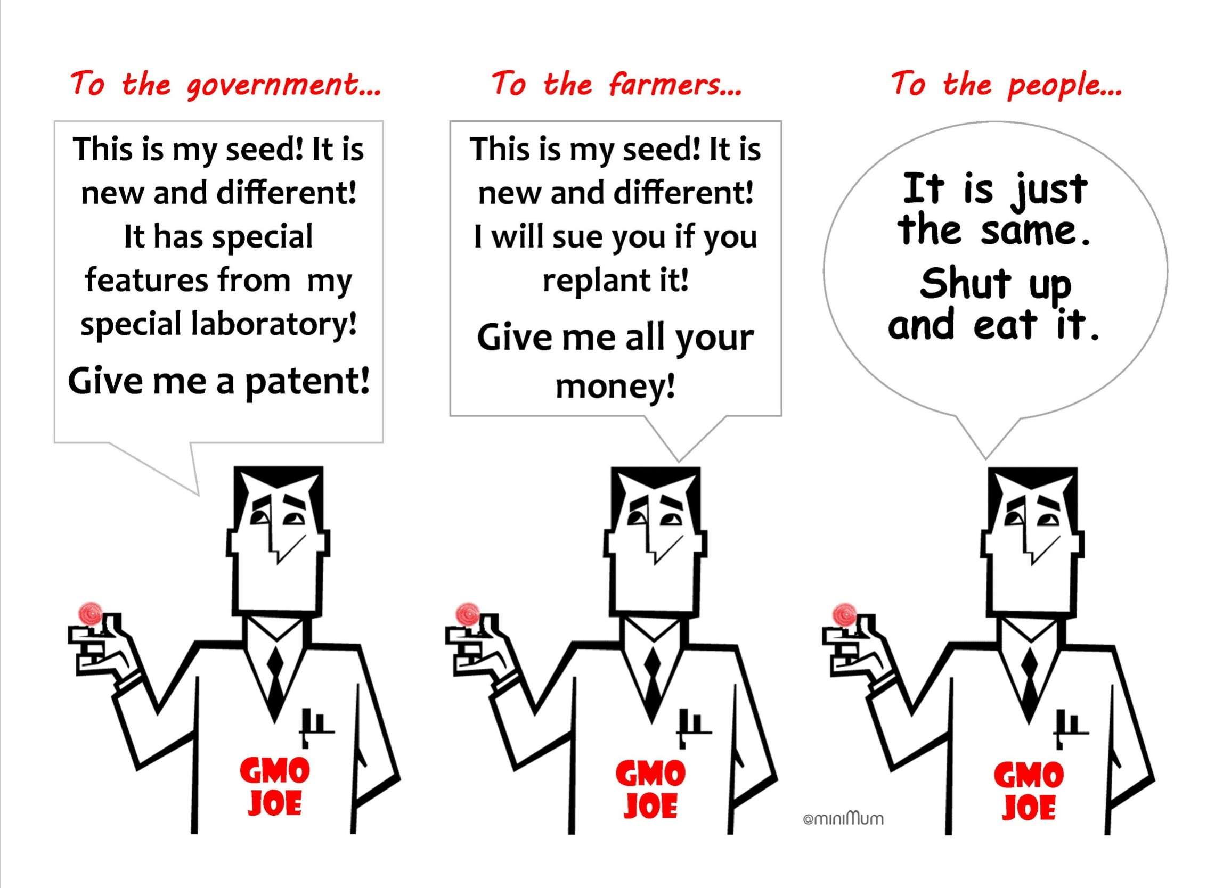

Slide 20
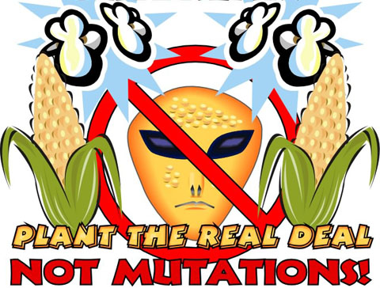

Slide 21
Gentically modified foods
Are genetically modified foods dangerous or unsafe?
Genetically Modified Corn – News Report
Genetically Modified Crops – Will they feed the world?

Slide 22
Cutting DNA
Restriction enzymes cut DNA at specific sequences called palindromes
Palindromes read the same forwards & backwards
Example: MOM & RACECAR
Useful to divide DNA into manageable fragments
Used in many aspects of DNA technology

Slide 23
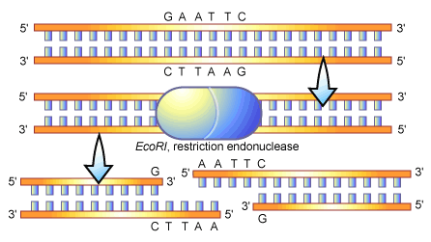
Restriction Enzymes & Cutting DNA
DNA is cut at: GAATTC
Cut b/w 1st G and 1st A
***Creates sticky ends

Slide 24
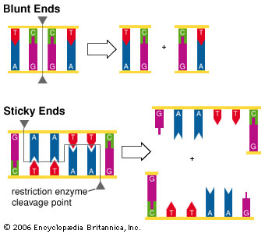
Restriction Enzymes & Cutting DNA
If the cut goes straight through the DNA → creates blunt ends
If the cut is staggered → creates sticky ends

Slide 25
Polymerase Chain Reaction
PCR
Can be used to make copies of selected segments of DNA for a DNA fingerprint.
Requires:
a) A primer: artificially made single-stranded sequence of DNA.
b) When these ingredients (DNA and Primer) are combined and incubated, the selected regions of DNA quickly double.

Slide 26
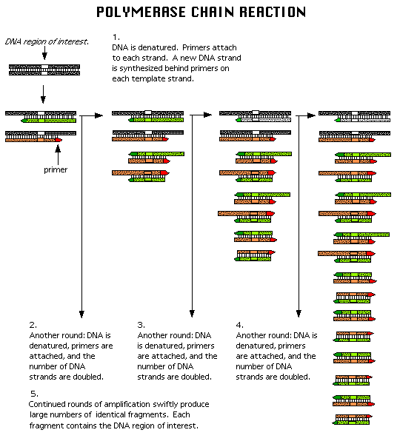
c) Every five minutes the sample of DNA doubles again, resulting in many copies of a sample in a short amount of time.
d) the new copies of the DNA sample can then be used to make a DNA fingerprint.
e) Used in
Paternity tests
Diagnosis of genetic disorders
Study of ancient fragments of DNA

Slide 27
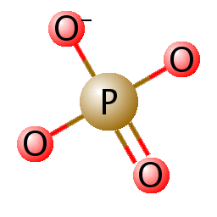
Gel Electrophoresis
Technique where DNA can be separated based on size and charge
The phosphate groups in DNA are negatively charged
DNA is placed in a gel and electricity is run through the gel

Slide 28
Gel Electrophoresis

Slide 29
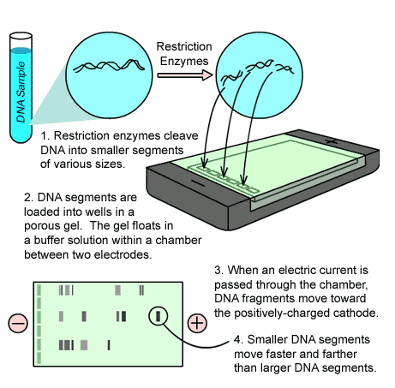
Gel Electrophoresis

Slide 30
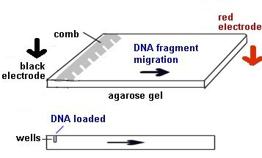
Electrophoresis
Negative DNA moves toward the positive end
Smaller fragments move farther and faster
Larger fragments move shorter and slower

Slide 31
Gel Electrophoresis
Creates a DNA Fingerprint
Each person has unique DNA (sequences of nitrogen bases); therefore, each person has a unique DNA fingerprint

Slide 32
Uses of DNA Fingerprints
Determines paternity
Match organ donors
Identification of the dead (crime & catastrophe victims)
September 11th
Determines if a suspect was/was not present at the scene of a crime
DOES NOT determine guilt or innocence!!!

Slide 33
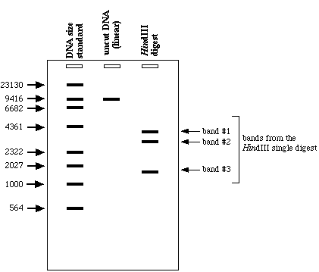
Example of DNA Fingerprint

Slide 34
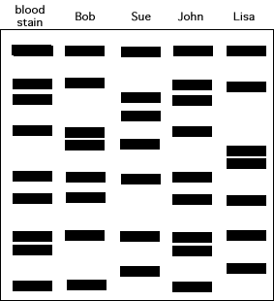
DNA Fingerprint
Who left the blood stain? - Bob, Sue, John, or Lisa??

Slide 35
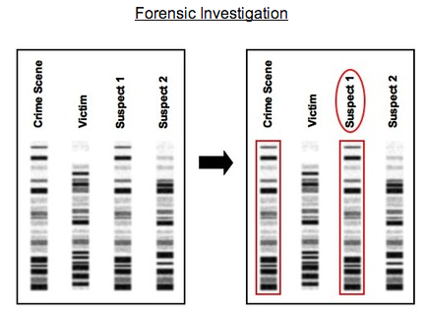

Slide 36
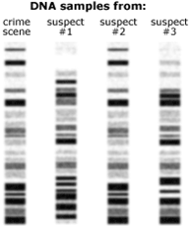

Slide 37
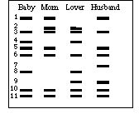

Slide 38
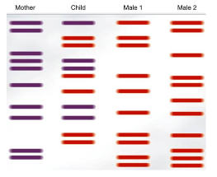

Slide 39
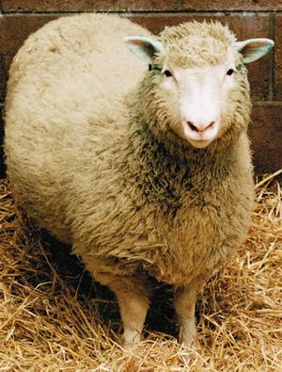
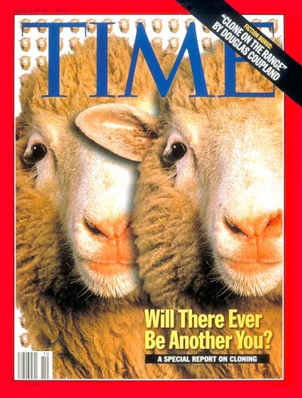
Cloning
A. What is a clone? →
Genetically identical copies
B. The Most Famous Clone: Dolly the Sheep
1. Clone from an adult sheep cell by Scottish
researcher Ian Wilmut
2. Had only one success in 300 tries.
3. Dolly grew to maturity, and successfully had a
lamb by natural means in 1998.
4. Dolly seems to be prematurely old.

Slide 40
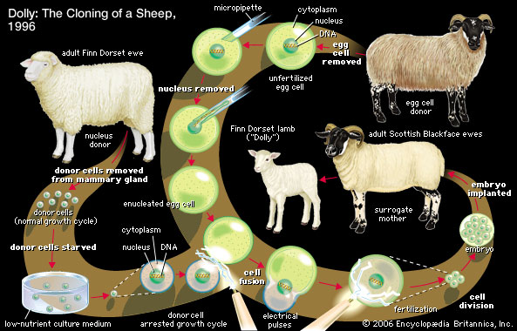
Cloning continued…..

Slide 41
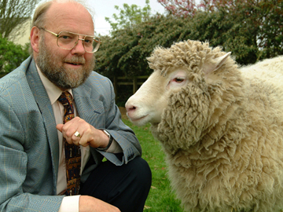
Cloning continued….
C. Since Dolly:
1. Cloning of this sort has now been done on cattle, pigs and mice also.
2. The success rate has improved considerably.
3. Cloning humans begins to show up in science fiction in 1970s.
D. Transgenic plants & animals could be cloned
E. What are some pros & cons of cloning?

Slide 42
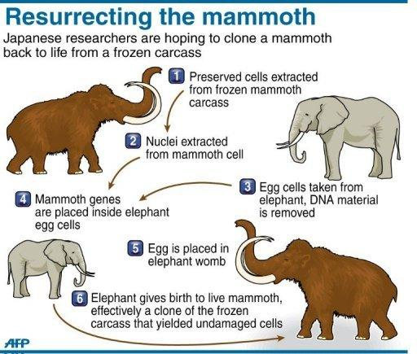
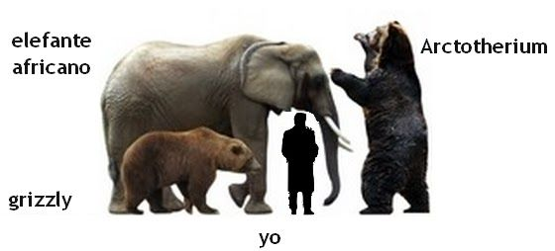
Should we?
Or shouldn’t
we

Slide 43
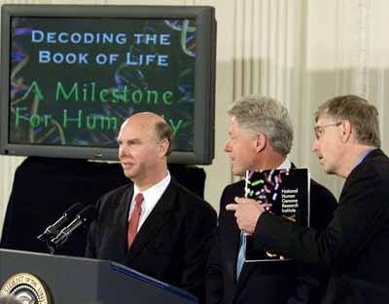
Human Genome Project
A. Effort to map/sequence the entire human
genome (all of our genes on every
chromosomes)
B. Finalized in 2003 by the US Government &
Celera Genomics

Slide 44
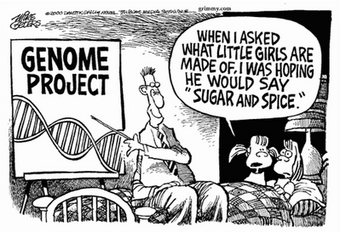
Human genome project

Slide 45
Gene therapy
Process of replacing an absent or faulty gene with a normal, working gene.
B. Recombinant viruses are often used as
vectors for inserting healthy genes into an
organism.
C. Gene Therapy – Sickle Cell Anemia

Slide 46
Summary
Science drives technology, and technology drives science.
Biotechnology has been around as long as humans have practiced agriculture.
Biotechnology is used to conduct research, develop new products, and improve processes.
DNA-based technologies have been developed in microbes.
As a society, we are responsible for using it wisely.

