Slide 1
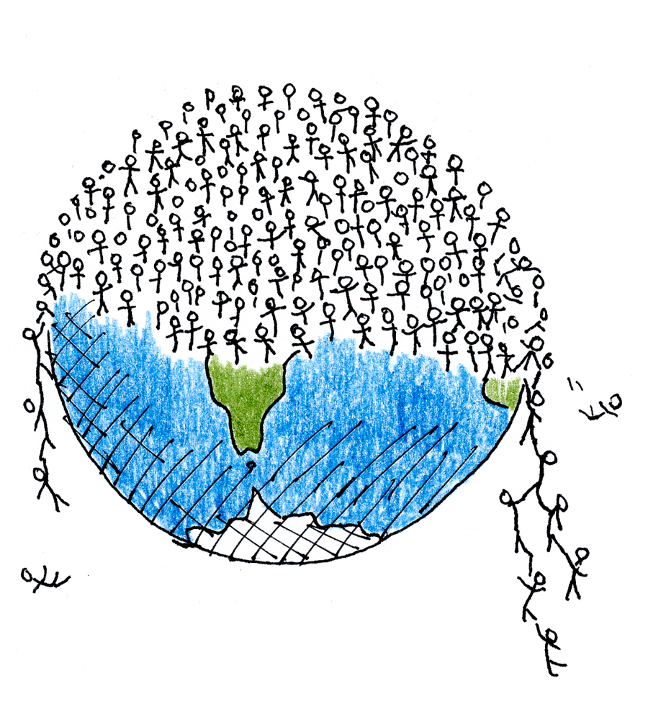
How Populations Grow
Three important characteristics of a population are geographic distribution, population density, and population growth rate.

Slide 2
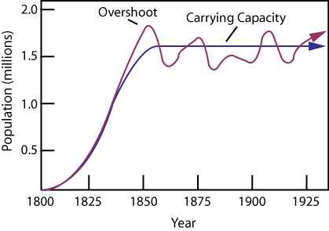
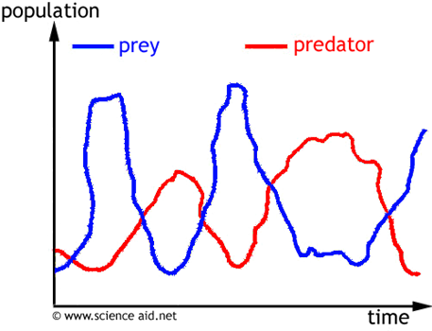
Explain what you think is happening to the population in this graph?
If it weren’t labelled for you how would be able to distinguish between predator and prey?

Slide 3
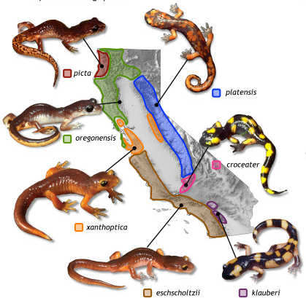
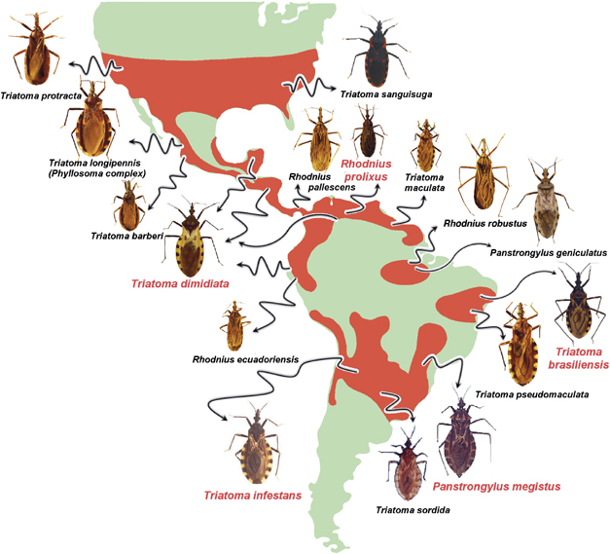
Geographic distribution
Also called range, is the area in which a population lives.

Slide 4
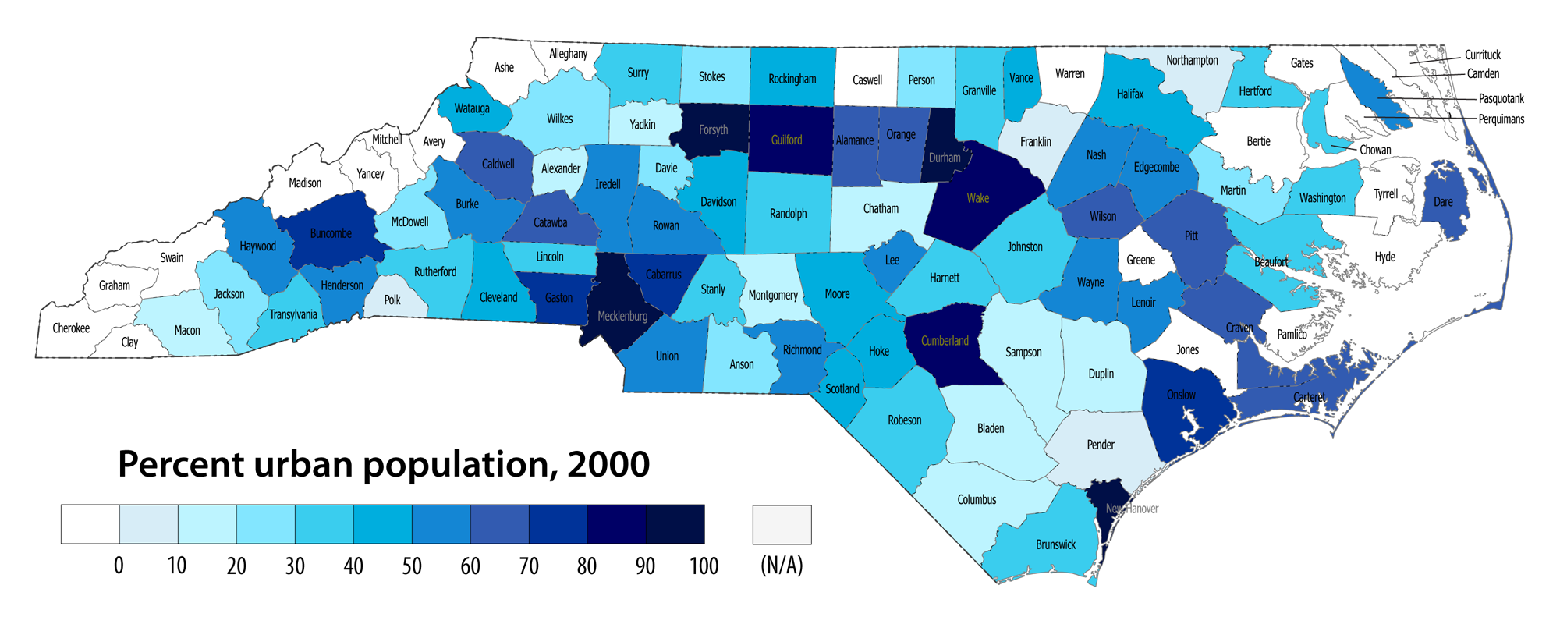
Population Density
The number of individuals per unit area.
An example is the number of people per square kilometer.

Slide 5
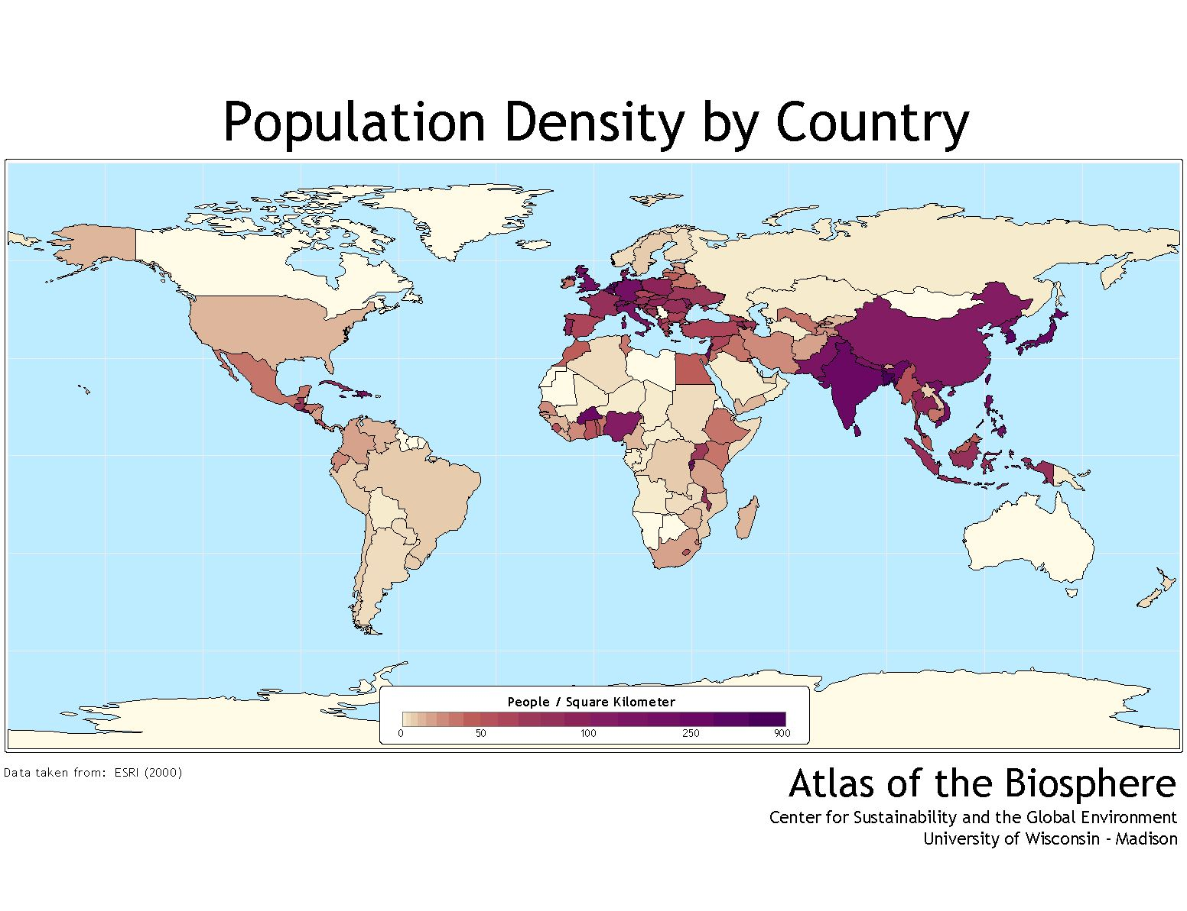

Slide 6
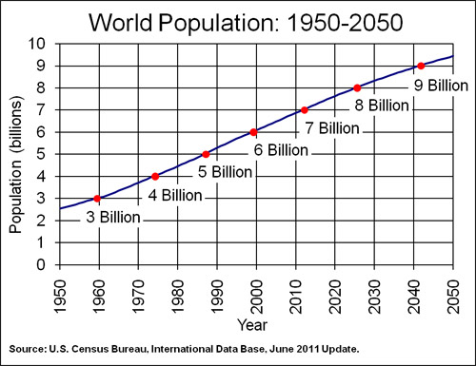
Population Growth Rate
How quickly a population increases or decreases in size.

Slide 7
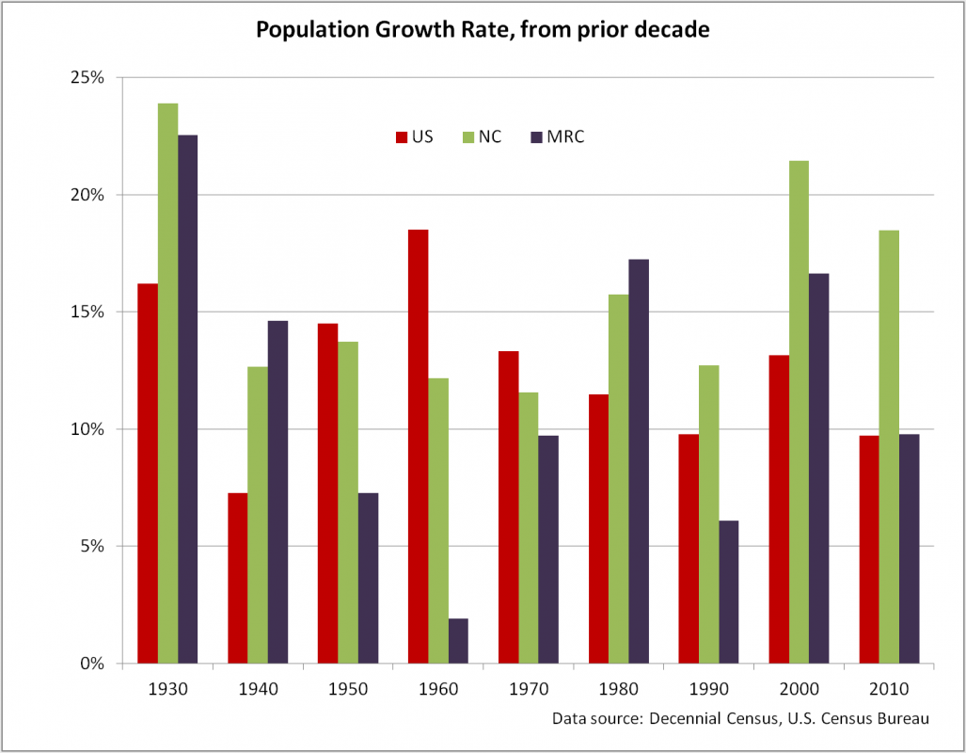

Slide 8
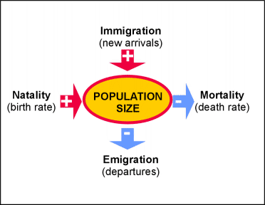
Population Size
Three factors can affect population size: the number of births, the number of deaths, and the number of individuals that enter or leave the population.

Slide 9
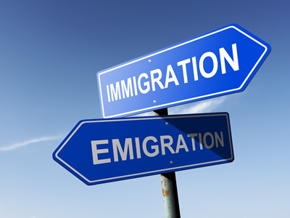
Immigration
The movement of individuals into an area.
Emigration
The movement of individuals out of an area.

Slide 10
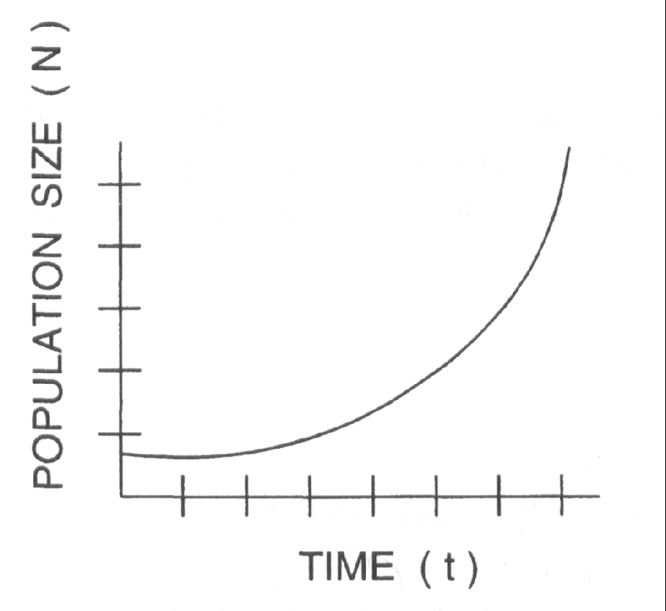
Exponential Growth
Occurs when members of a population reproduce at a constant rate.
Also called, J-shaped curve
Under ideal conditions with unlimited resources, a population will grow exponentially.

Slide 11
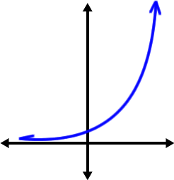
J-Shaped Curve

Slide 12
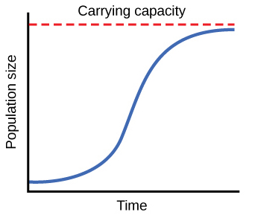
Logistic Growth
As resources become less available, the growth of a population slows or stops.
Also called, S-Shaped curve
This form of growth occurs when a population’s growth slows or stops.

Slide 13
S-Shaped Curve

Slide 14
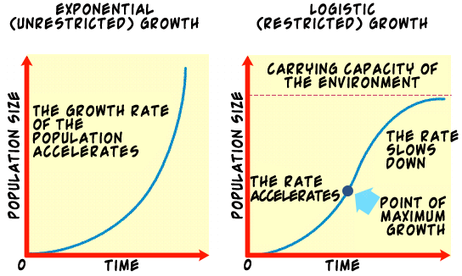

Slide 15
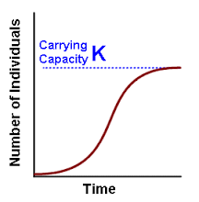
Carrying Capacity
The number of individuals of a specific species a given environment can support.
If, for example, resources start run out or space becomes limited, a population that was growing exponentially may start to slow or stop.
Often represented by the letter K.
K

Slide 16
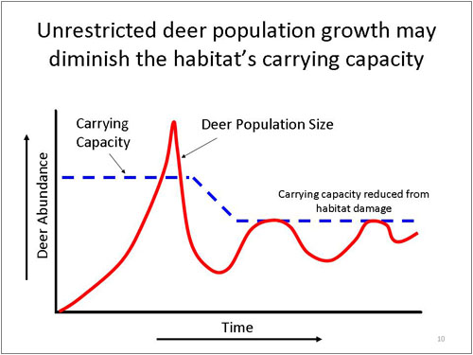

Slide 17
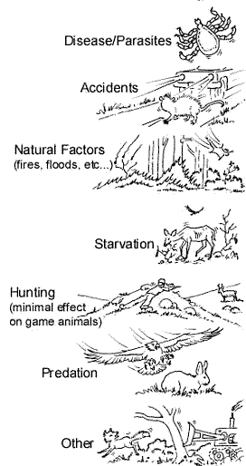
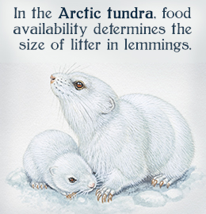
Limits to Growth
A limiting factor is anything that slows population growth. There are two kinds of limiting factor.
Density-dependent limiting factors
Density-independent limiting factors

Slide 18
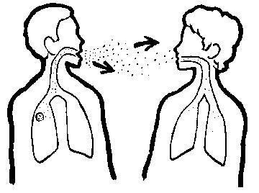
Density-Dependent Limiting Factors
The effect of these limiting factors increases as populations increases.
Food
Parasitism
Territory
Predation
Waste build up
Contagious Disease

Slide 19
Predator-Prey Relationships
How do you distinguish between predator and prey?

Slide 20
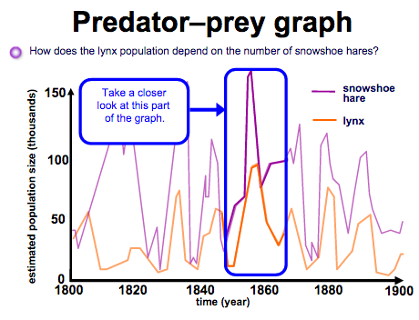

Slide 21
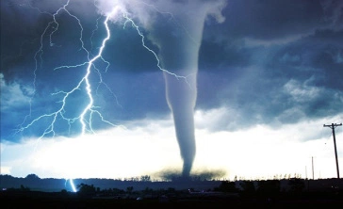
Density-Independent Limiting Factors
These limiting factors do not rely on population size.
They include natural disasters and human activities such as damming rivers.
When such factors occur many species show a rapid drop in population size.
Examples:
Temperature
Storms
Habitat destruction
Drought

Slide 22
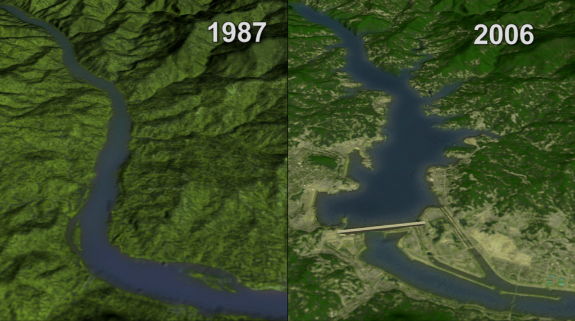
Long term effects of Damming

Slide 23
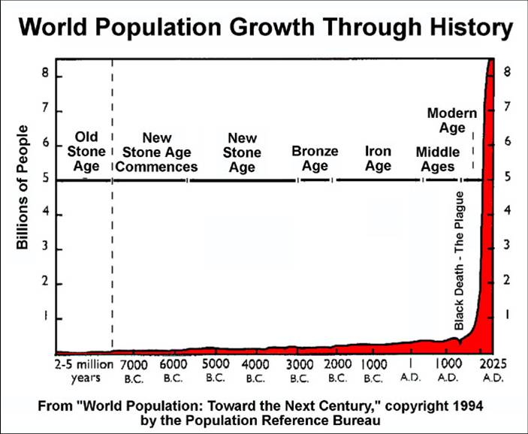
Human Population Growth

Slide 24
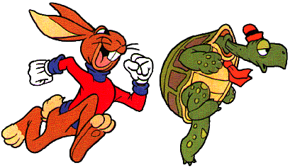
Demography
The study of human populations
Their goal is to predict how human populations will change over time.
Birth rates, death rates and age-structure diagrams help predict why some countries grow slowly while other experience rapid growth.

Slide 25
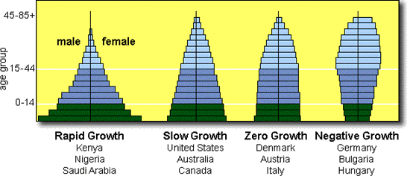
Age-Structure Diagrams
A bar graph showing how many people of each sex are in each age group in a population.

Slide 26
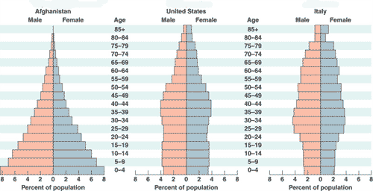
Describe the type of growth in each.

Slide 27
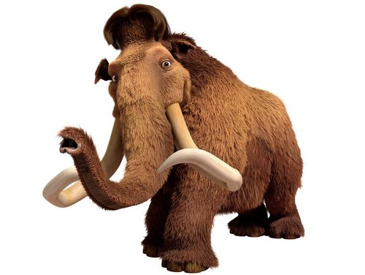
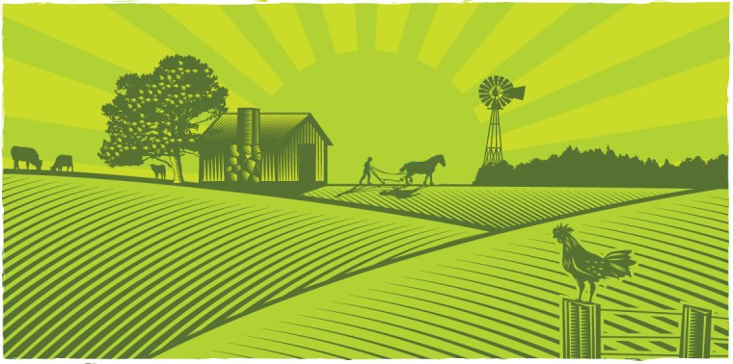
A Changing Landscape
Humans are the main source of environmental change.
Activities that affect the biosphere are hunting, gathering, agriculture, industry and urban development.

