Slide 1
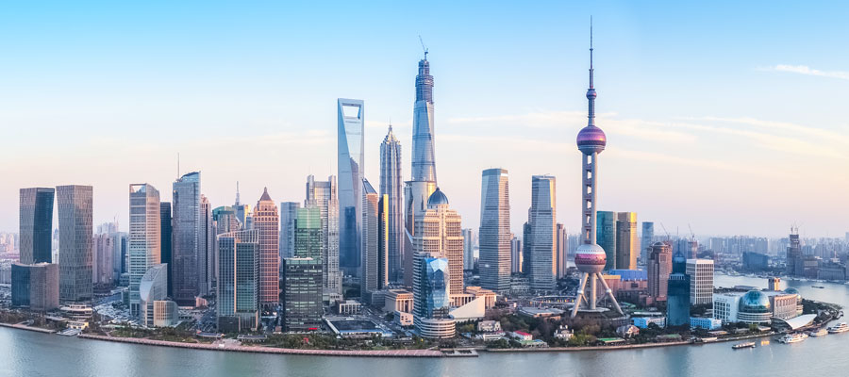
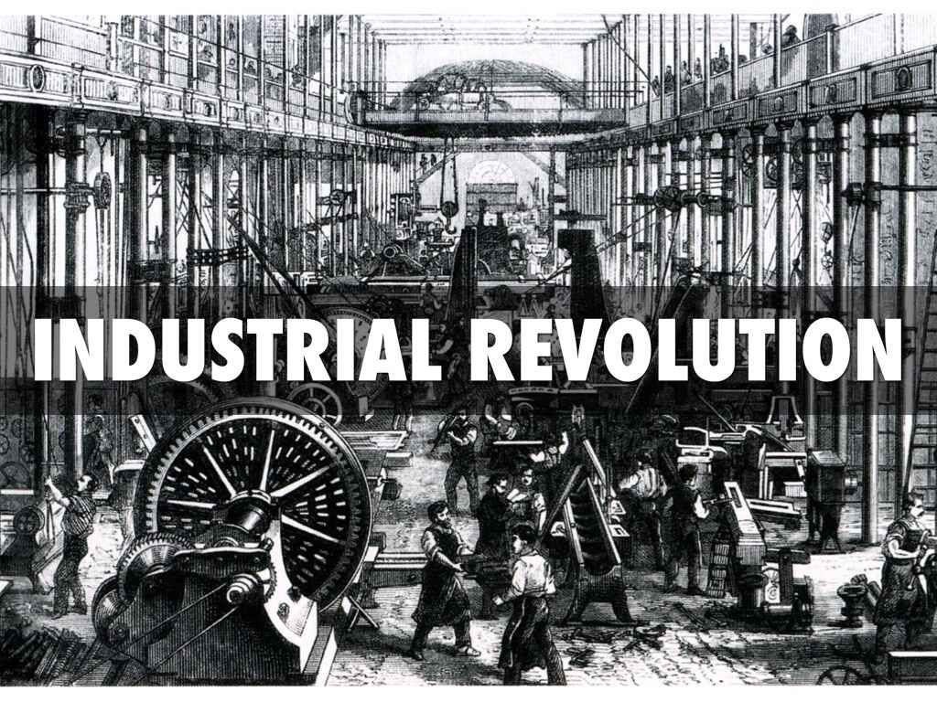
Shanghai, China
Industry used more resources and produced more pollution than ever before.
Cities also produce more pollution.

Slide 2
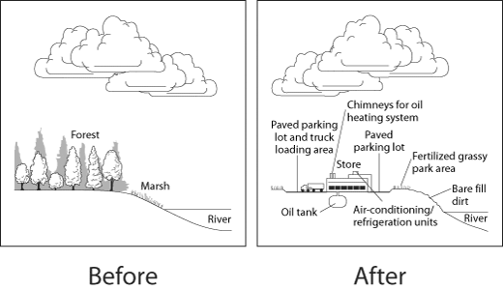
The impact of human activities on resources
Human activities can affect the quality and supply of resources.

Slide 3
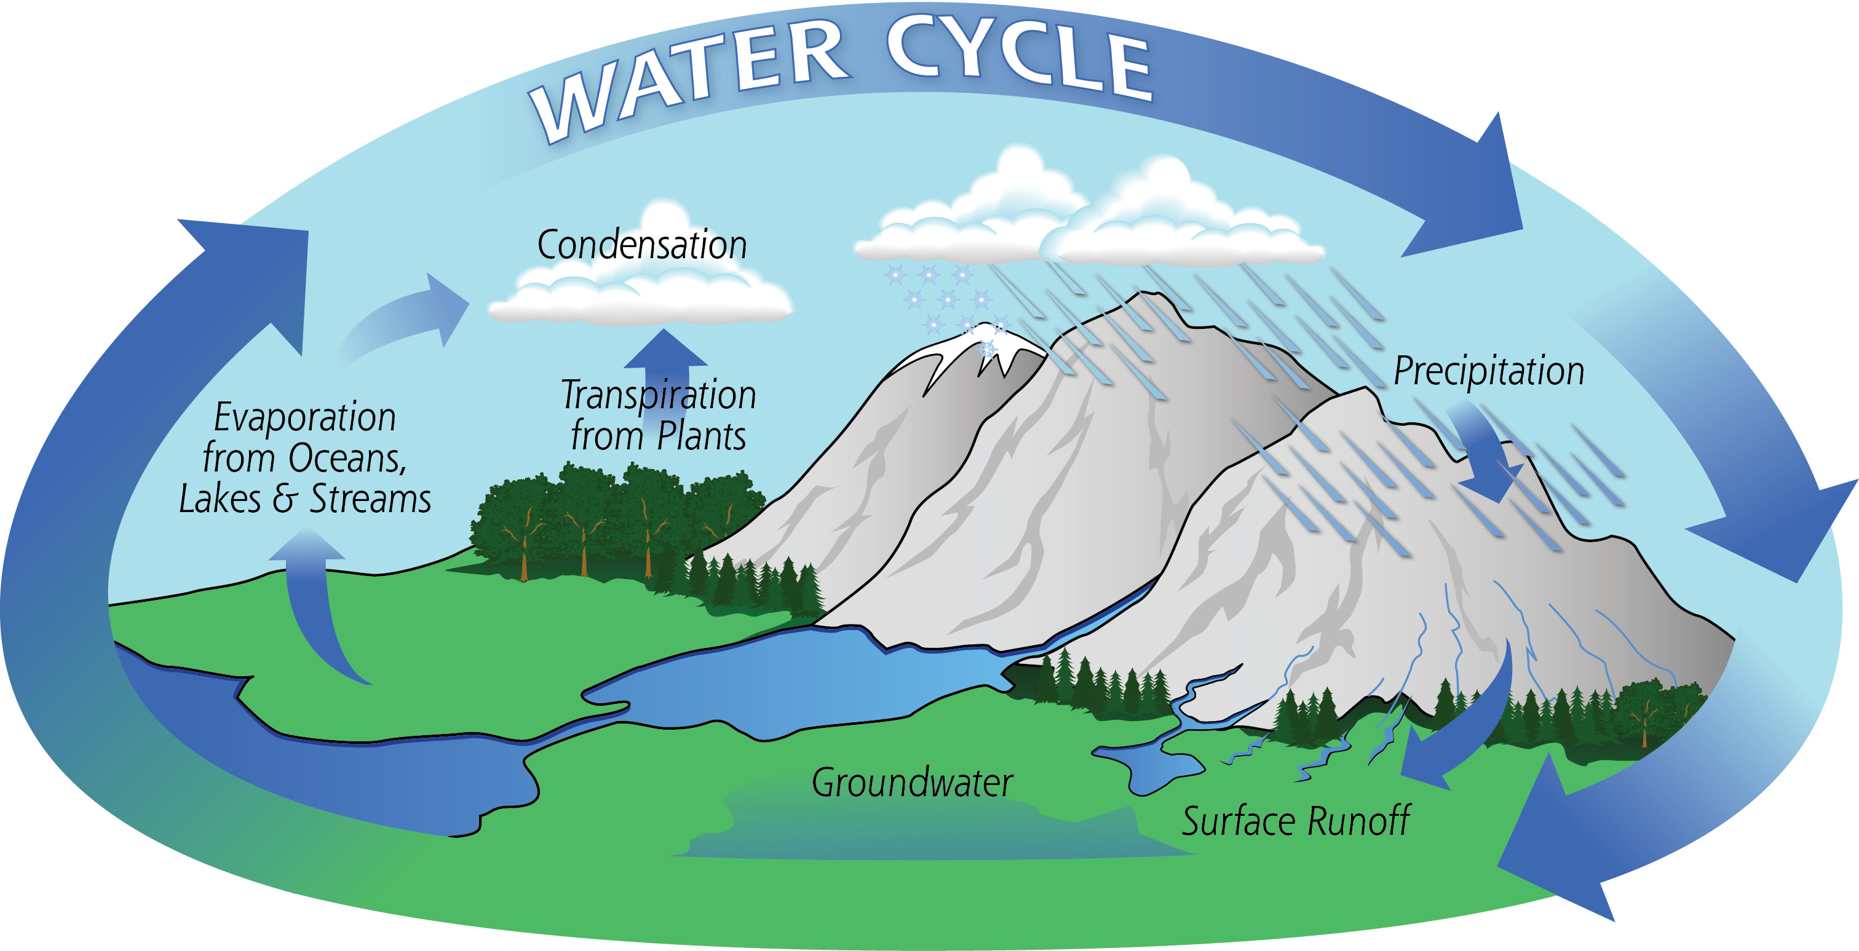
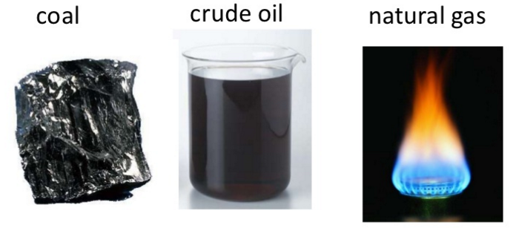
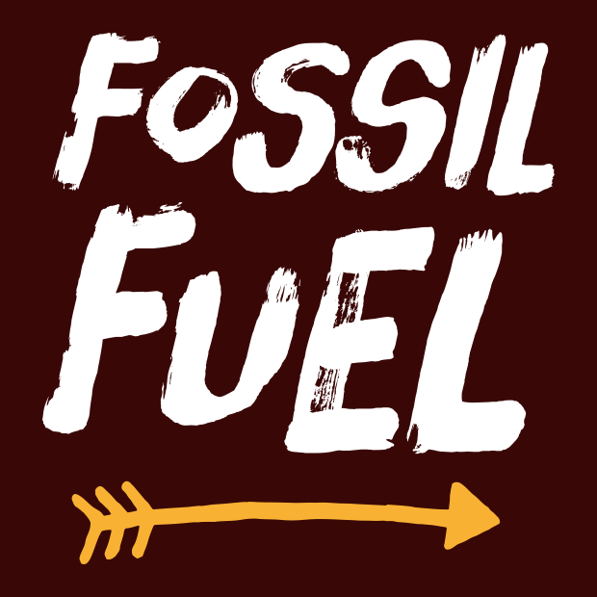
Renewable and Nonrenewable Resources
Resources may be classified as:
Renewable resources: those that a natural process can replace.
Nonrenewable resources: those that cannot be replaced by a natural process.
Fossil Fuels take millions of years to form.

Slide 4
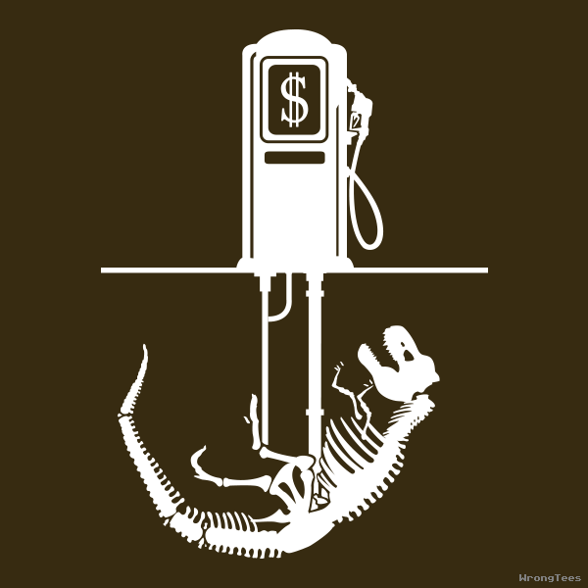
Fossil Fuels

Slide 5
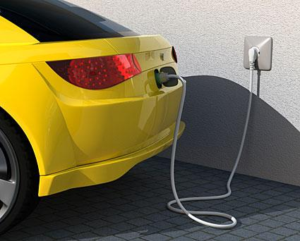
Alternative Fuel Sources

Slide 6
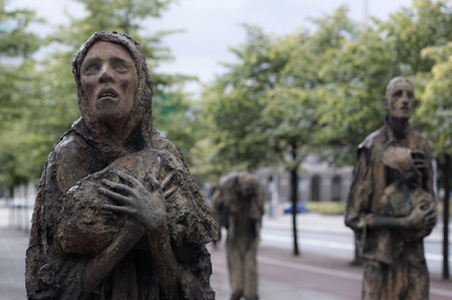
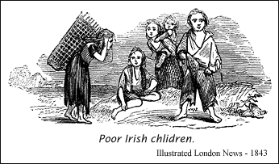
Monoculture
The planting of fields with the same crop year after year.
Increases the ability to mechanize planting, weeding and harvest.
The entire crop is susceptible to a single pest outbreak.

Slide 7
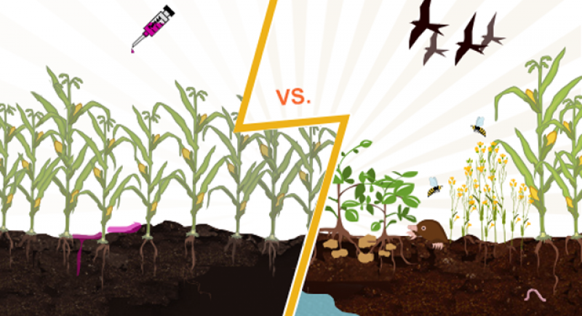
Green Revolution

Slide 8
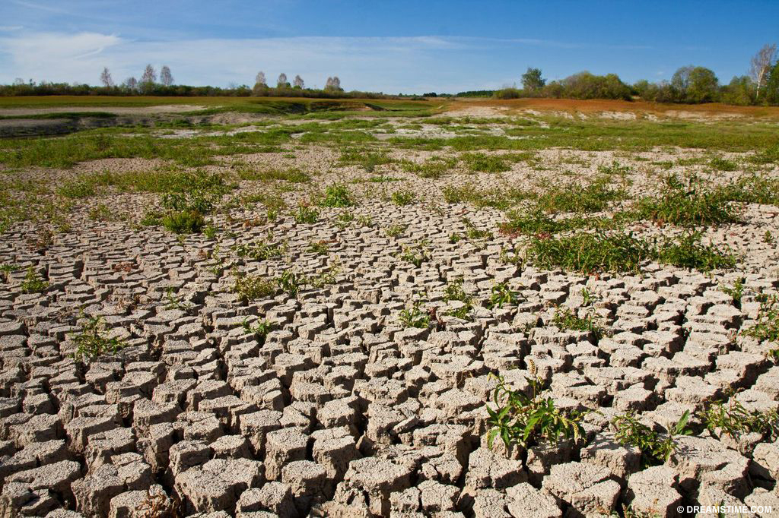
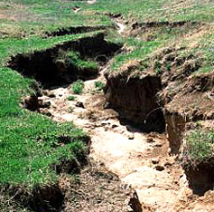
Soil Erosion
Wearing away of surface soil by water and wind.
In some areas, soil erosion has changed good soils into deserts.

Slide 9
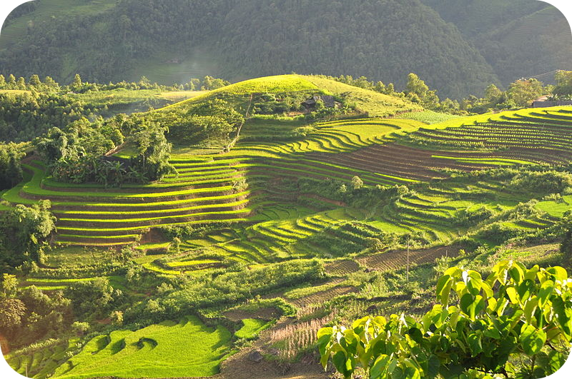
Contour plowing

Slide 10
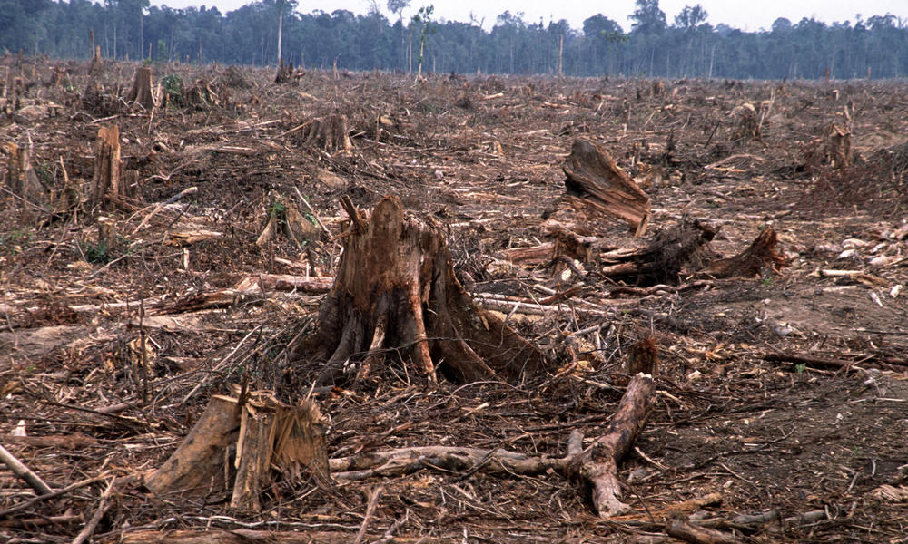
Deforestation
Loss of forests.
Forests supply wood, oxygen, and other resources.

Slide 11
Conservation

Slide 12
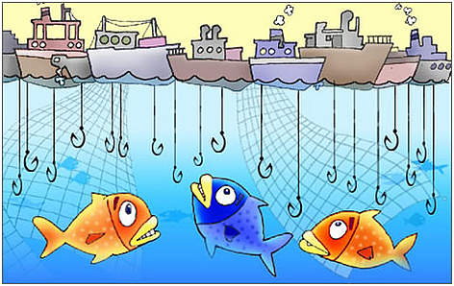
Overfishing
Loss of fish species.
Fish provide food for many countries and are an important part of the oceans ecosystems.

Slide 13
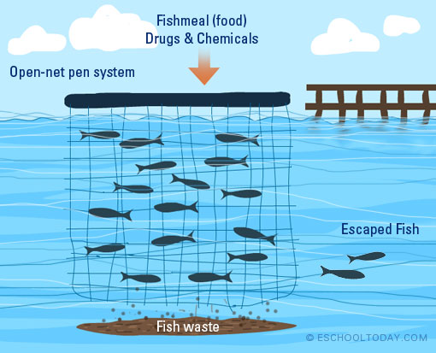
Aquaculture

Slide 14
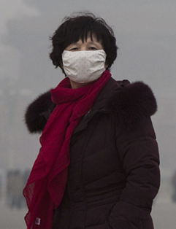
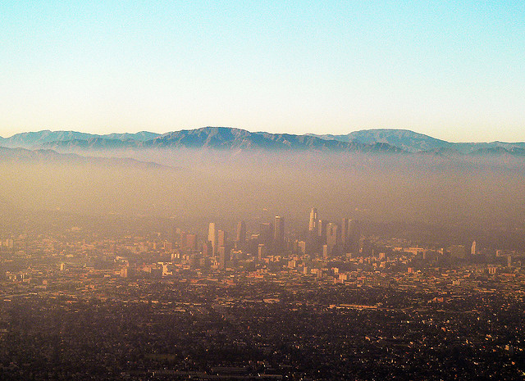
Smog
Mixture of chemicals that forms a gray-brown haze in the air.
Mainly caused by cars and industry.

Slide 15
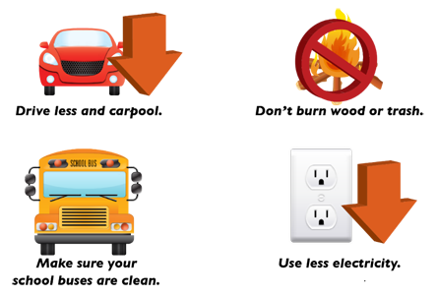
Emission controls

Slide 16
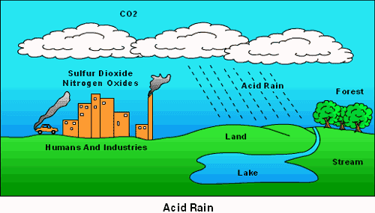
Acid Rain
Some of the chemicals in smog join with water vapor in the air.
Acid rain kills plants and causes other damage.

Slide 17
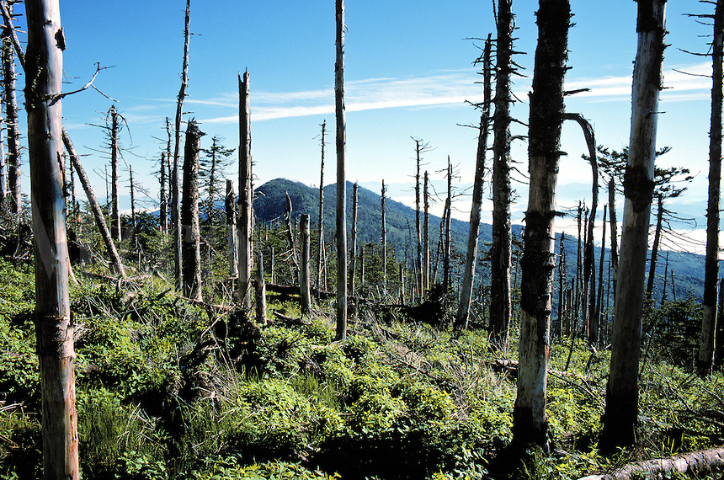
Acid rain in North Carolina

Slide 18
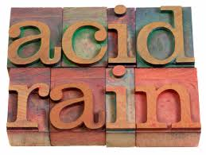
Acid rain and other damage

Slide 19
Emission controls

Slide 20
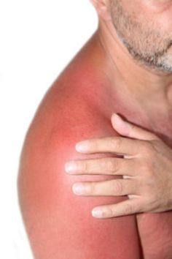
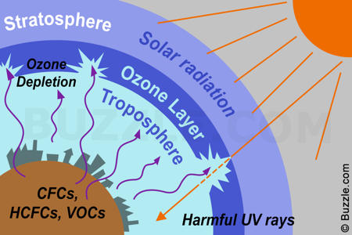
Ozone Depletion
The ozone layer is an area high in the atmosphere that protects the earth from harmful radiation.

Slide 21
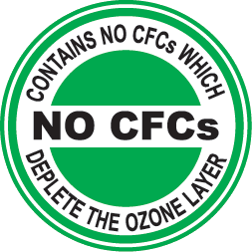
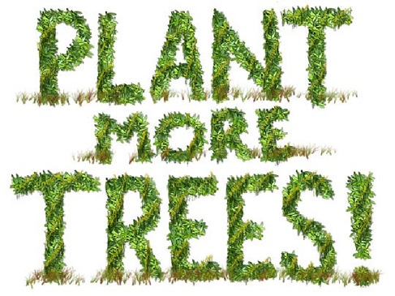
How do I protect the Ozone Layer?
Aerosol sprays
Air Conditioning
Use of refrigeration

Slide 22
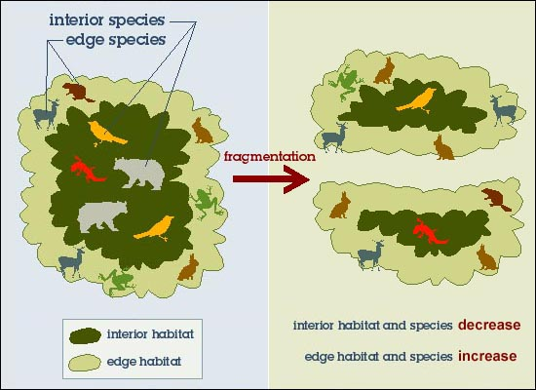
Habitat Fragmentation
Human developments can split habitats
The smaller the pieces of habitat, the less likely its species can survive.

Slide 23
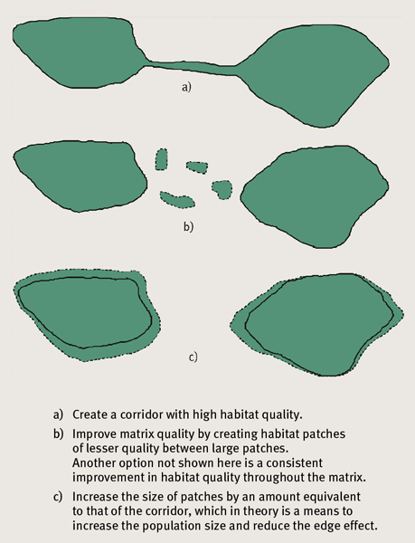
Linking Fragments Reduce Edge Effect

Slide 24
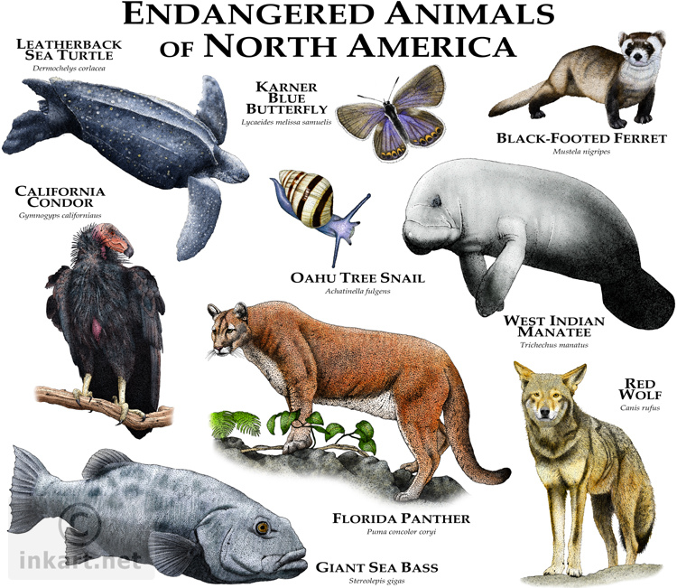
Endangered Species
A species whose population size is declining in a way that places it in danger of extinction.

Slide 25
Conservation Societies & Awareness Campaigns

Slide 26
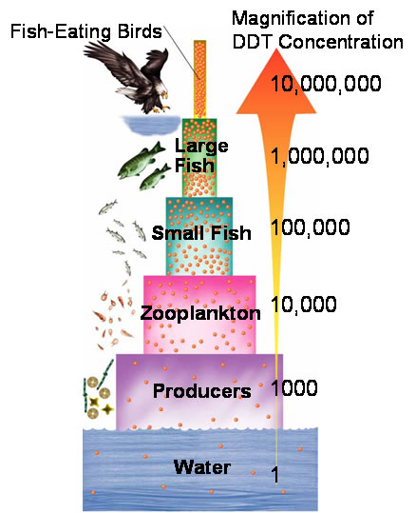
Biological Magnification
Toxic compounds build up in the bodies of organisms.
The concentration of toxic compounds increases the higher the trophic level.
Examples of toxic compounds are lead, mercury and DDT

Slide 27
Sickness Levels

Slide 28
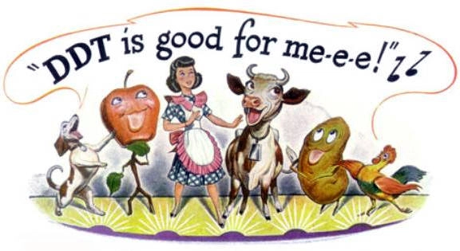
Awareness

Slide 29
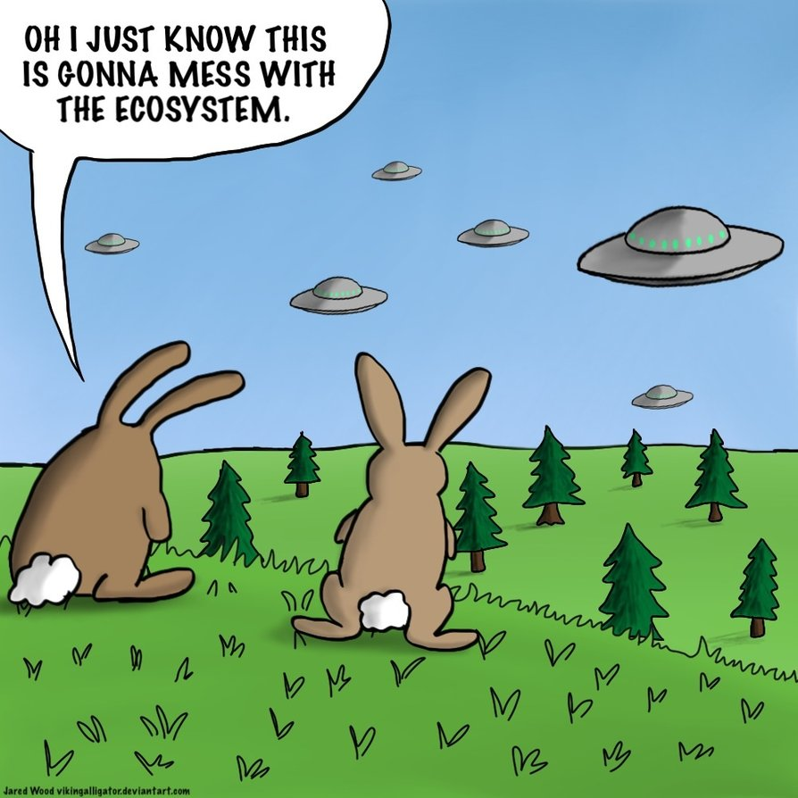
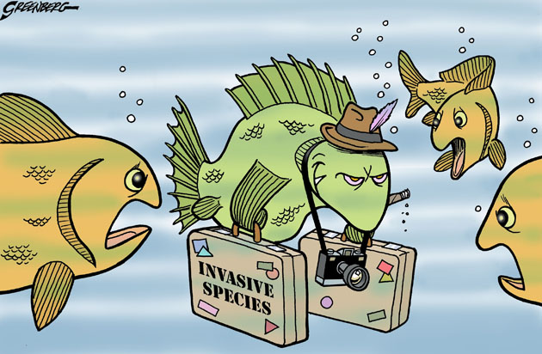
Invasive Species
Plants and animals brought into an area from other places
Invasive species can multiply quickly if their new habitat lacks parasites and predators to control their numbers.

Slide 30
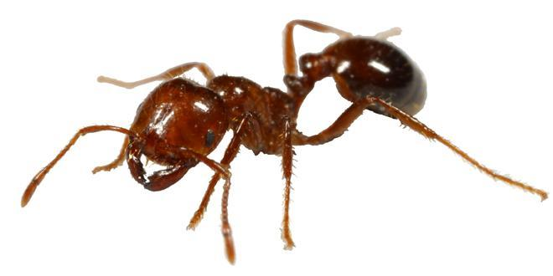
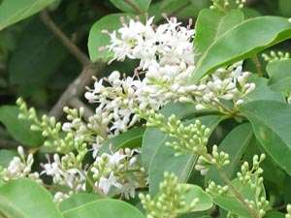
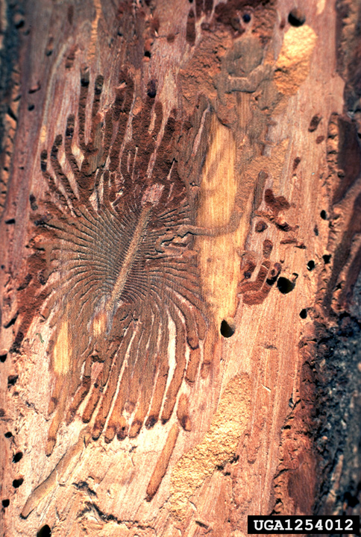
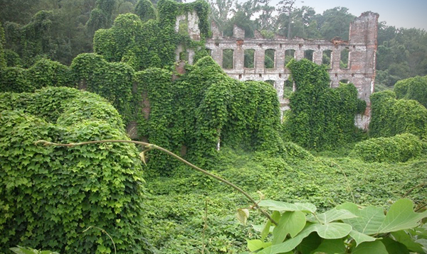
North Carolina Invasive Species

Slide 31
Awareness

Slide 32
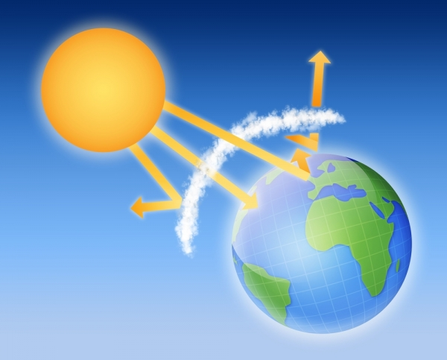
Greenhouse Effect
Greenhouse
Effect

Slide 33
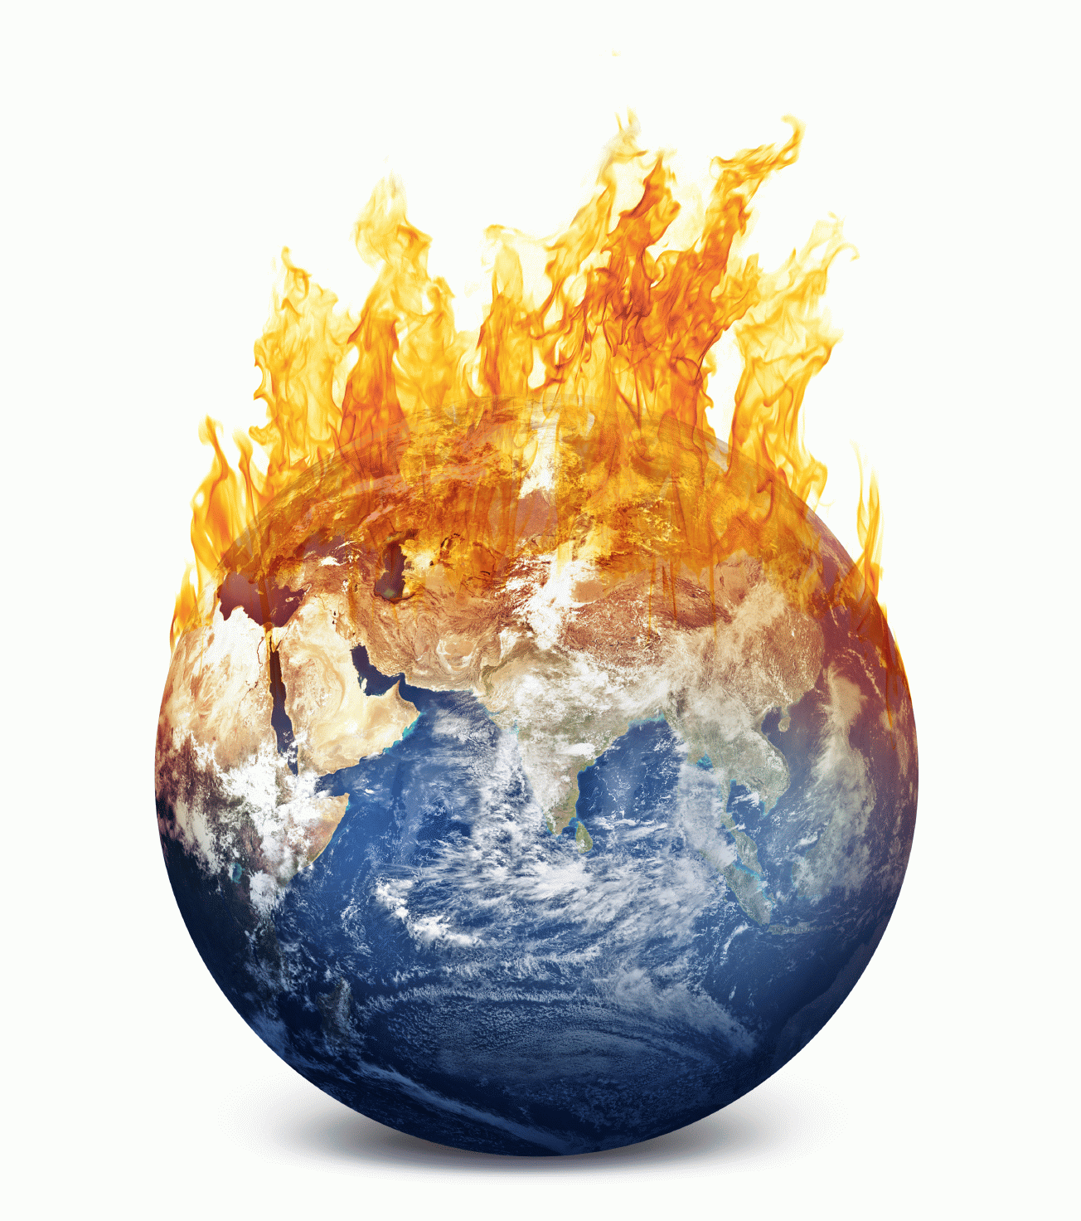
Global Warming
Is an increase in the average temperature of the biosphere.
Global warming is the result of the burning of fossil fuels.
Continued global warming may lead to rising sea levels and coastal flooding.

Slide 34
Conservation

