Slide 1
Let’s take it back…
In your end of course biology book read pages 194 & 195.
1. How did the layers of Earth form?
2. What was the importance of the active volcanoes?
3. What were the gases of early earth?
4. Compare and contrast early earth’s atmosphere to our current atmosphere.
5. Write about the Miller and Urey experiment.
6. Define primordial soup. → google it
Notes:
High temperatures on early earth caused most of the rock to melt and separate. Dense materials sank (forming core) and lighter materials rose (forming mantle and crust)
Volcanoes released water vapor which built up the atmosphere. Water condensed and fell back to earth as rain.
Water vapor, methane, hydrogen, nitrogen, ammonia, carbon dioxide, and carbon monoxide.
Now – free oxygen, layer of ozone protection, keeps earth at suitable temp. Early – lacked free oxygen, contained so much carbon monoxide, carbon dioxide, methane, and ammonia to be toxic.
Miller Urey showed amino acids could form from matter present on early earth.

Slide 2
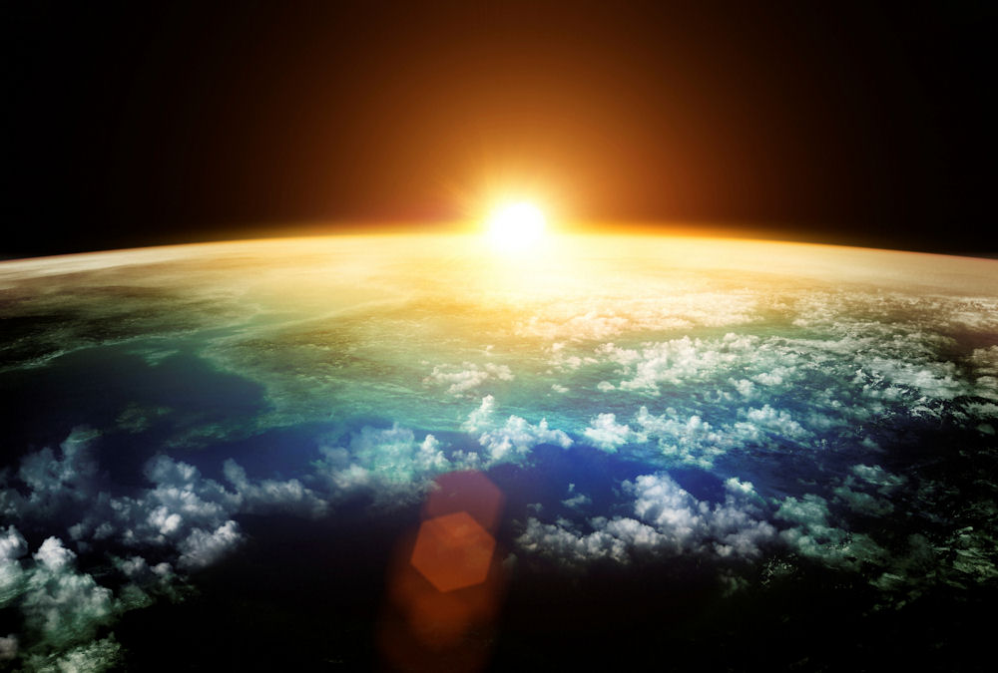
Why can we live on Earth?
Identify several conditions that allows earth to sustain life.
How did these items come to be?
Notes:
Presence of liquid water, moderate temperature range, free oxygen in the atmosphere, adequate sunlight, absence of toxic substances in the atmosphere, absence of lethal radiation.

Slide 3
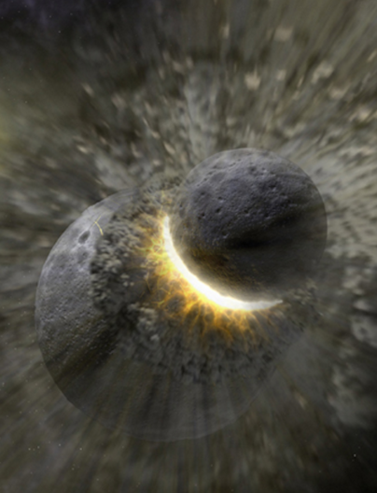
Earth is about 4.6 billion years old
At first the Earth was extremely hot
The early atmosphere probably consisted of:
Hydrogen cyanide, Carbon dioxide, Carbon monoxide, Nitrogen, Hydrogen sulfide and Methane
No liquid water present until the Earth was approximately 1 billion years old.

Slide 4
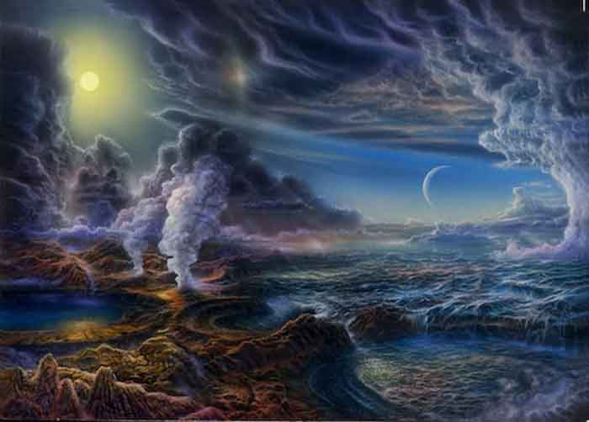
Earth’s Earliest Self-Portrait

Slide 5
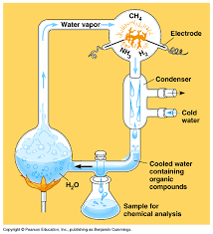
Miller and Urey Experiment
Simulated the conditions of early Earth in a lab setting.
They filled a flask with hydrogen, methane, ammonia, and water then passed electric sparks through the mixture.
Notes:
HOT:
Why did Miller and Urey choose these gases to use in the experiment?
What does the electric spark represent?

Slide 6
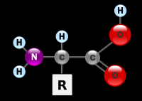
Miller Urey Results
Amino acids began to accumulate.
Shows how mixtures of organic compounds necessary for life could have arisen from simpler compounds present on Early Earth.
One of Miller’s experiments produced cytosine and uracil.
https://www.youtube.com/watch?v=EZkMd_rP-rk
Notes:
HOT:
Identify the parts of the amino acid.
What part differs between amino acids. How many R groups are there?
Where do we find cytosine and uracil in biology?

Slide 7
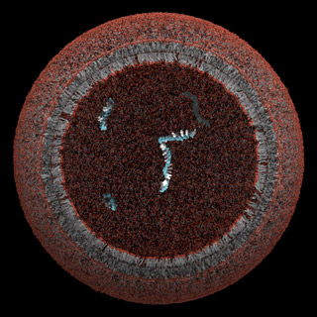
What did the first cell look like?
Bacterial Cell
Prokaryote (no nucleus or organelles)
Heterotroph
Anaerobic

Slide 8
Heterotroph Hypothesis

Slide 9
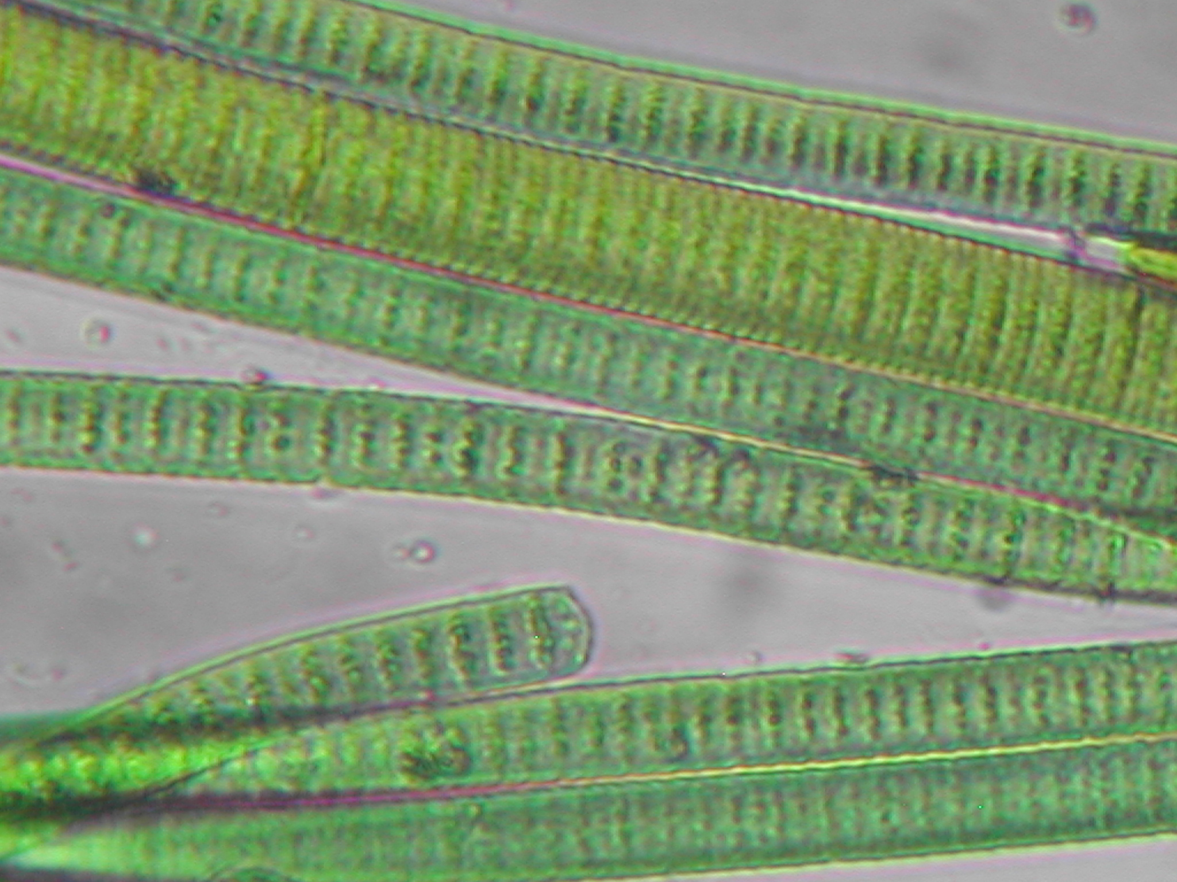
Next came photosynthetic prokaryotes…
The cell was able to photosynthesize.
Was green because chlorophyll was present.
Release oxygen into the atmosphere.
Photosynthesis Equation: ___________________________________________________

Slide 10
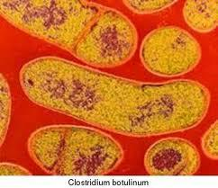
Then came aerobic prokaryotes…
What does it mean to be aerobic?

Slide 11
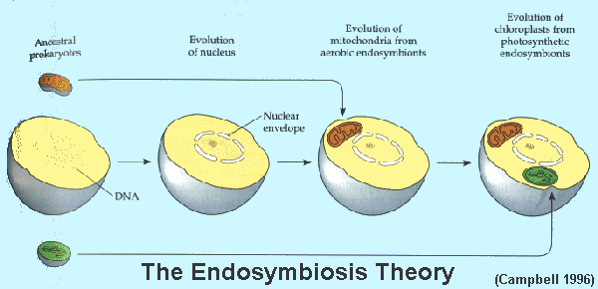
Formation of Eukaryote Cells
Eukaryotes appeared when one prokaryote began living inside of another. This belief is called the Endosymbiont Theory.
These prokaryotes became organelles known as the chloroplast and mitochondria.

Slide 12
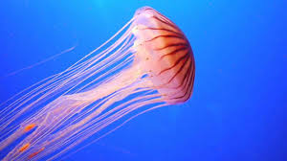
Finally, came a multicellular organism
These eukaryotes began to live together and formed the first multicellular organism.

Slide 13
The Evolution of Life on Earth
https://www.youtube.com/watch?v=H2_6cqa2cP4

Slide 14
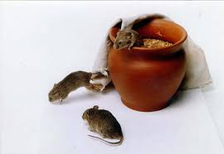
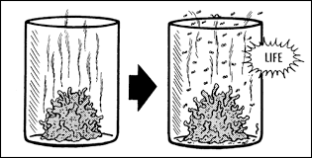
Thoughts on how life arose.
Spontaneous Generation Theory aka “Abiogenesis”
Spontaneous: to happen without cause or reason
Generation: to make or initial creation

Slide 15
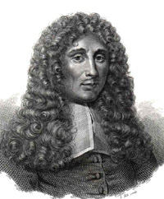
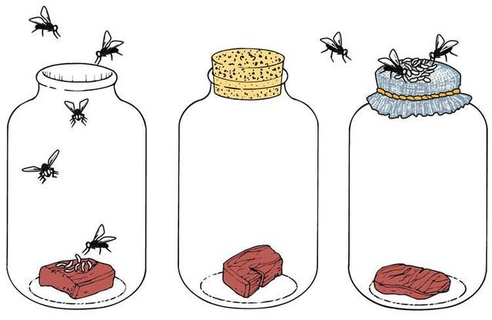
Spontaneous Scientists
Francesco Redi: An Italian scientist that speculated that vermin such as insects, worms and frogs do not arise spontaneously.
Redi set up a series of flasks containing meats.
Only flasks which allowed adult flies in and out contained maggots.

Slide 16
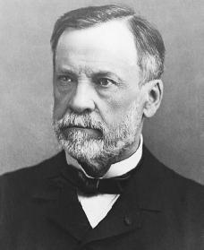
Spontaneous Scientists
Louis Pasteur: A French scientist who created vaccines for rabies but also designed an experiment in 1859 that disproved spontaneous generation.
Pasteur expanded upon the works of Redi

