Slide 1
Community Interactions
Competition, predation and symbiosis, can powerfully affect an ecosystem.

Slide 2
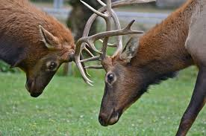
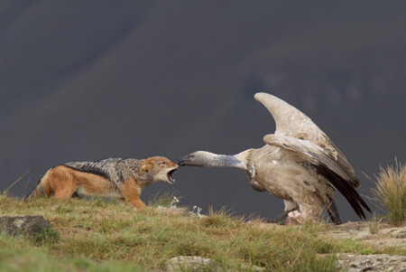
Competition
Competition occurs when living things try to use the same resources. Competition often results in one organism dying out.
Resource
Mating

Slide 3
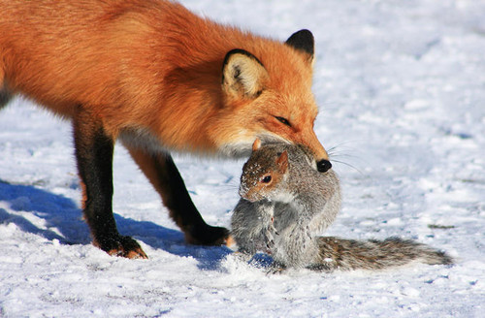
Predation
Predation occurs when one organism (the predator) captures and eats another (the prey).

Slide 4
Mutualism: both species benefit from their relationship
Commensalism: one species benefits. The other is neither helped nor harmed.
Parasitism: One species benefits by living in or on the other. The other species is harmed.

Slide 5
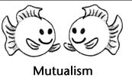
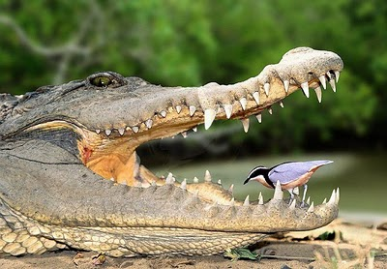
Mutualism

Slide 6
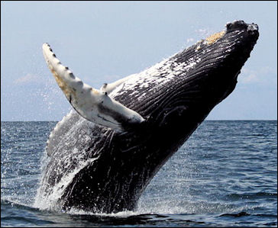
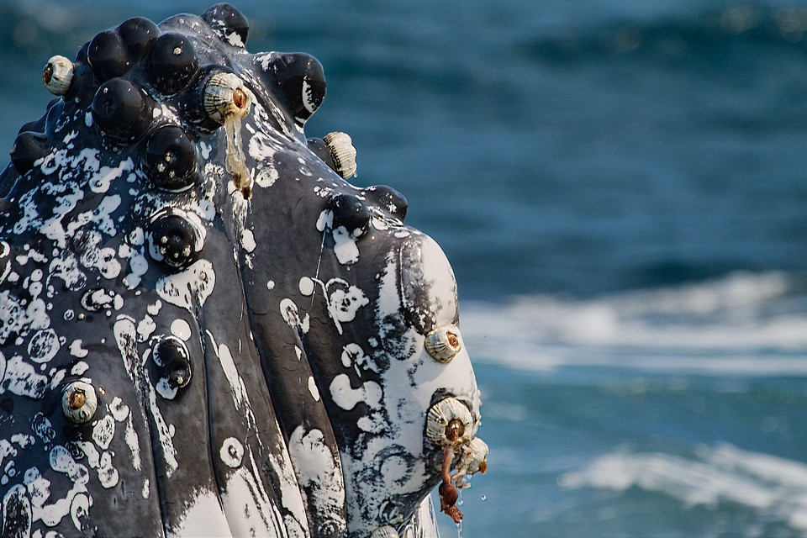
Commensalism

Slide 7
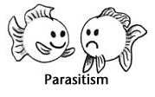
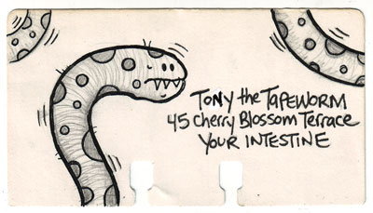
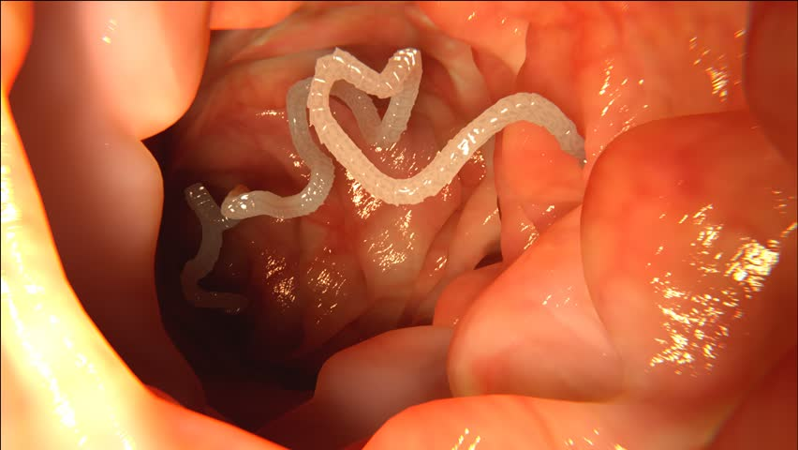
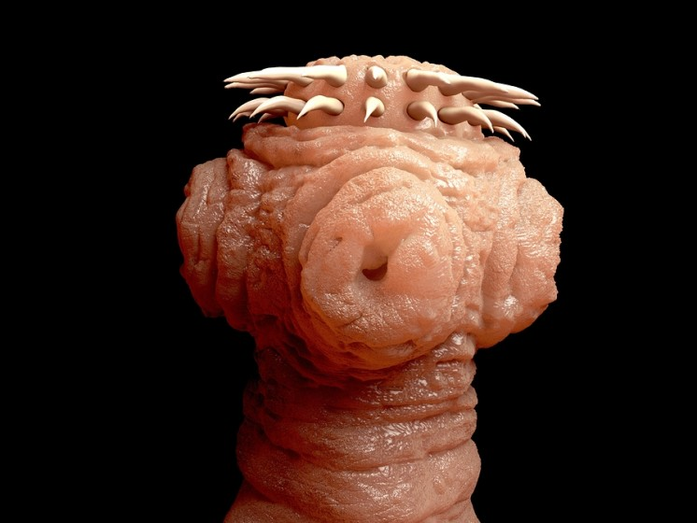
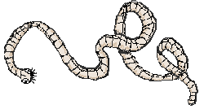
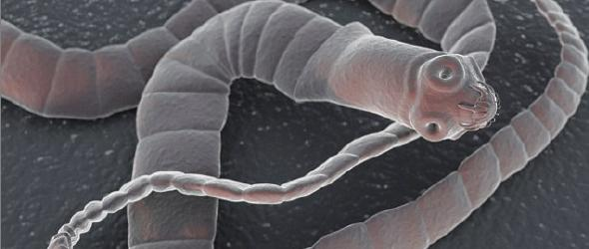
Parasitism

Slide 8
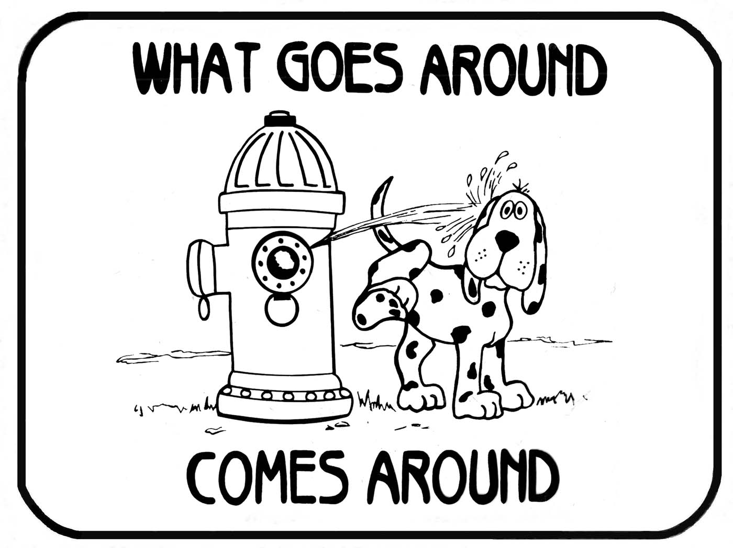
Cycles of Matter
Energy and matter move through the biosphere very differently.
MATTER IS RECYCLED!!!
Matter, including water and nutrients, move through organisms and parts of the earth through BIOGEOCHEMICAL CYCLES.

Slide 9
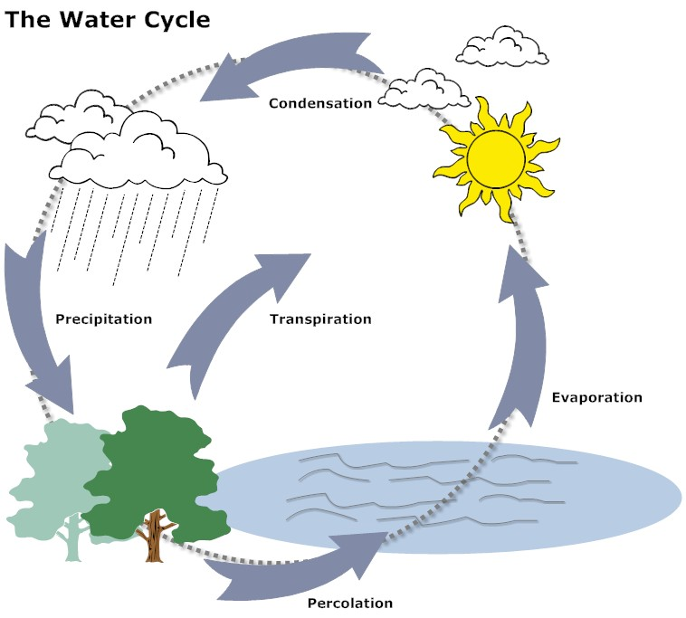
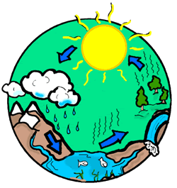
The Water Cycle
All living things need water to survive.
Water cycles between the ocean, atmosphere, land and living things.

Slide 10
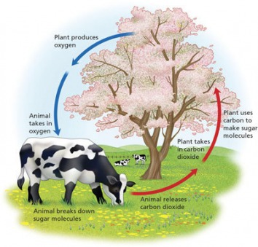
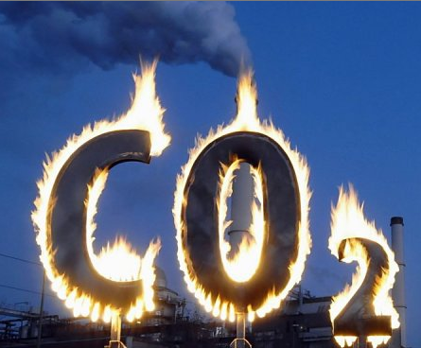
Carbon Cycle
Carbon is a key part of living tissue.
Photosynthesis/Cellular Respiration are parts of the carbon cycle.
Human activities such as burning fossil fuels are also parts of the carbon cycle.

Slide 11
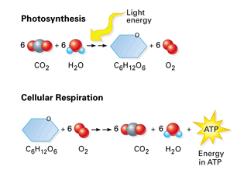
Photosynthesis/Cellular Respiration

Slide 12
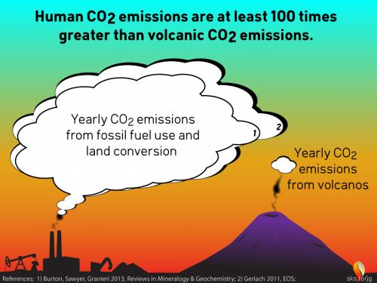
Burning Fossil Fuels/Natural Activities

Slide 13
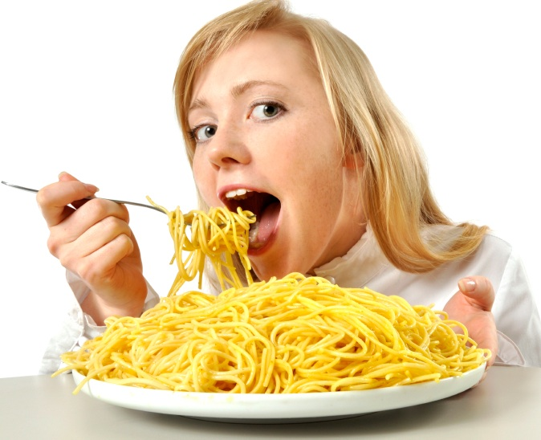
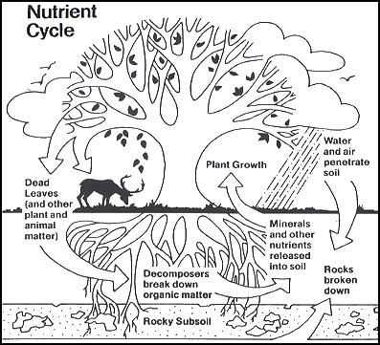
Nutrient Cycles
Nutrients are chemical substances that organisms need to survive.
Every living organism needs nutrients to build tissues and carry out essential life functions.
Nutrients are passed between organisms and the environment.

Slide 14
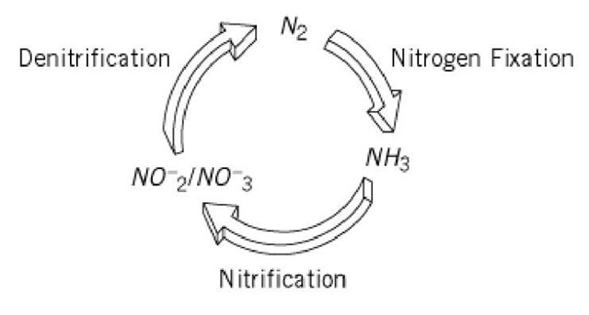
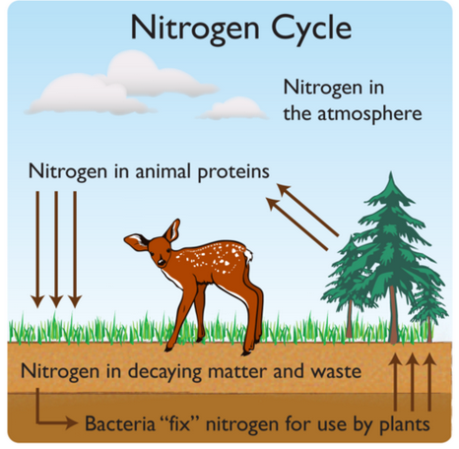
The Nitrogen Cycle
Organisms need nitrogen to build proteins & DNA.
Nitrogen gas is the most abundant form of nitrogen on Earth.
Only certain forms of bacteria can use nitrogen gas.
Changing nitrogen gas into ammonia is called nitrogen fixation.

Slide 15
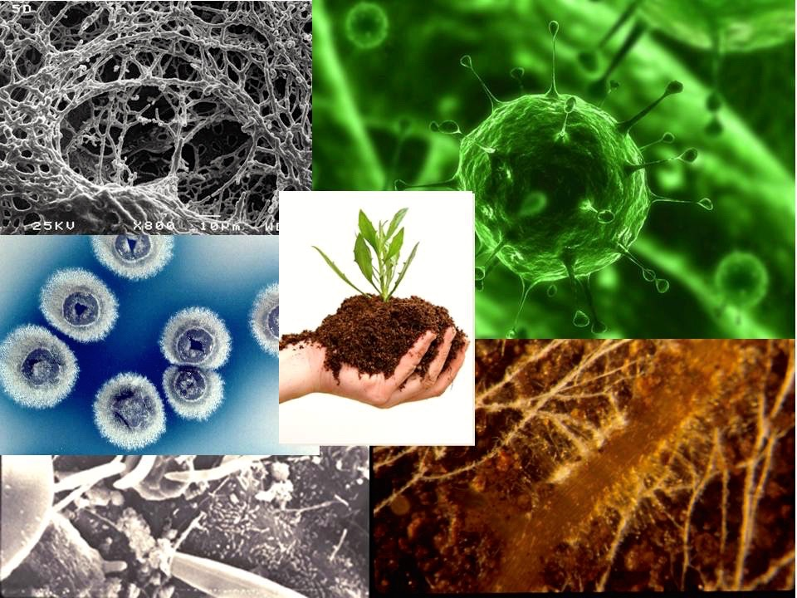
The Nitrogen Cycle
Soil bacteria can also convert ammonia into nitrates.
Nitrates are plant food.
When organisms die, decomposers return nitrogen to the soil.
Soil bacteria can convert nitrates back into nitrogen gas this is called denitrification.

Slide 16
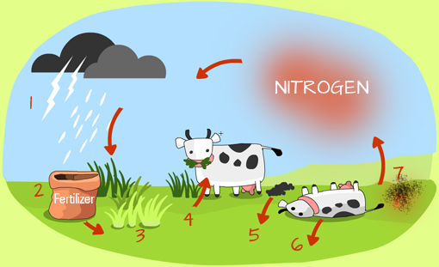

Slide 17
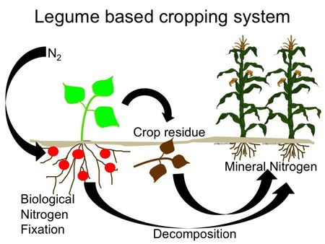
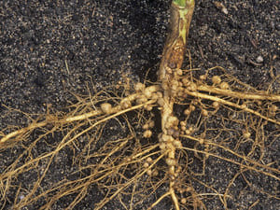
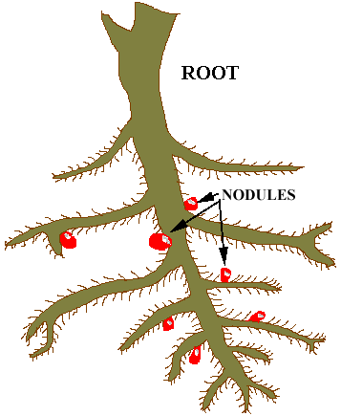
Nitrogen is introduced to the soil by rain, lightning (precipitation).
Nitrates don’t come from Nitrogen in the air. They are obtained by nitrifying bacteria in the soil. Some root nodules can convert ammonia in the soil into nitrates.

Slide 18
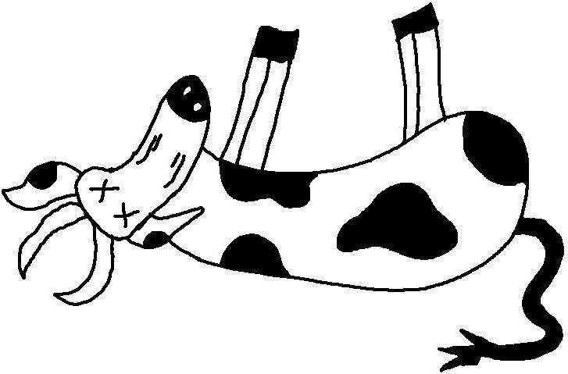
Plants build up proteins using nitrates absorbed from the soil.
When animals like cows, eat these plants, they, in turn, use it to build animal protein.
When animals/plants die and are broken down by decomposers the nitrogen is reintroduced into the soil in the form of ammonia.
When animals pee or poop and the waste is broken down by decomposers the nitrogen is reintroduced into the soil in the form of ammonia.

Slide 19
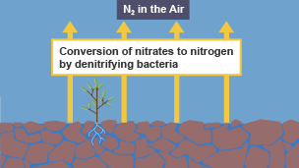
Nitrates in the soil can also be broken down by denitrifying bacteria (in specific conditions) and is then sent into the the air as nitrogen. This process can help make the soil infertile because it will lack the nitrates needed for plant use.
Once nitrogen gets back to the air, the cycle starts again.

