Slide 1
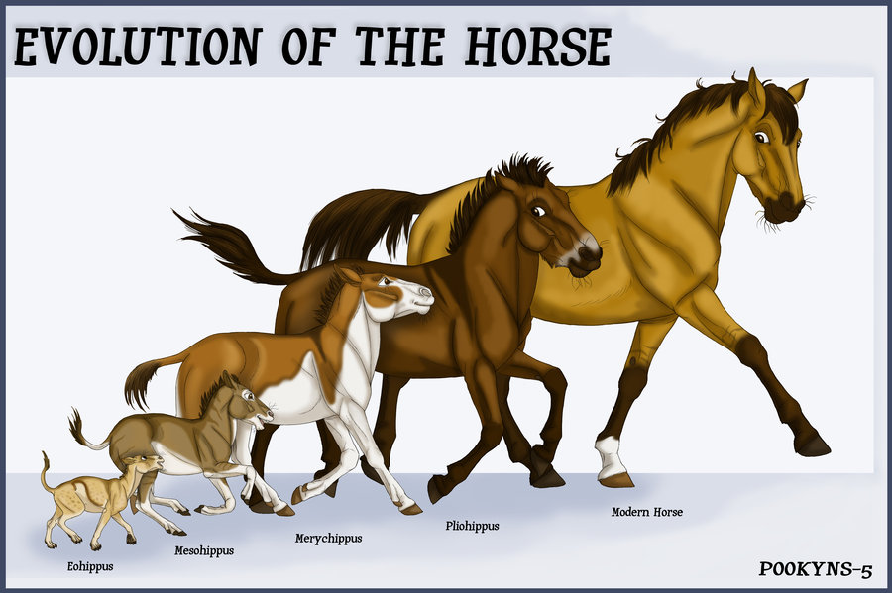
Descent with modification

Slide 3
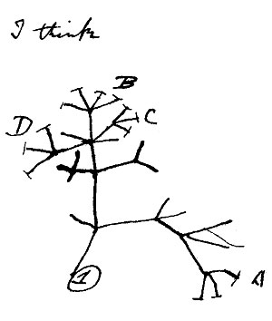
Principle of Common Descent
Darwin argued that many species alive today would have common ancestors.
Darwin stated that living things have been adapting to life on earth for millions of years
He presented four types of evidence in support of this idea.

Slide 4
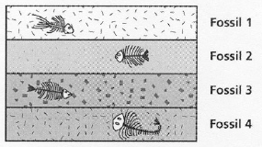
Evidence #1: The Fossil Record
Comparing fossils from older and younger rock layers provides evidence that change over time has taken place.

Slide 5
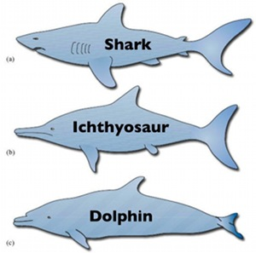
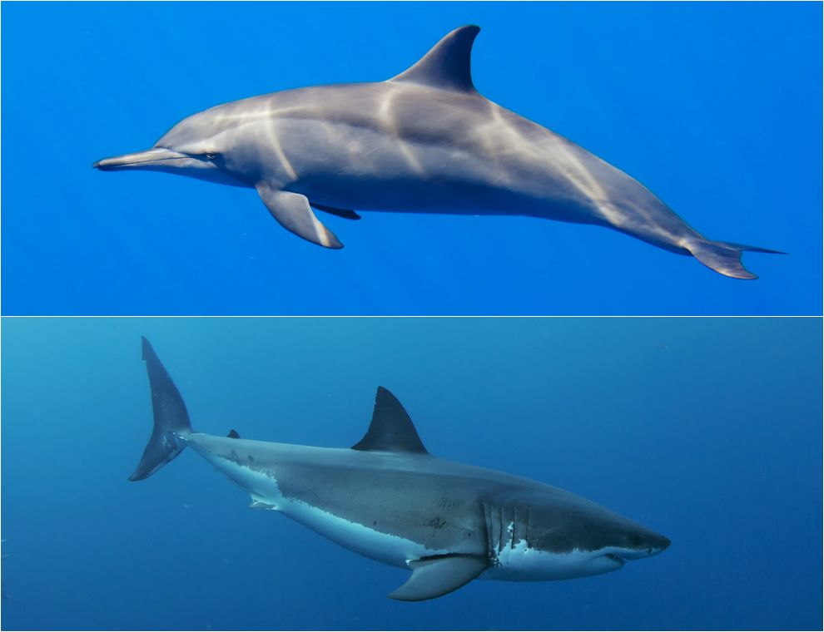
Evidence #2: Geographic distribution
of living organisms
The presence of similar but unrelated organisms in similar environments suggest change over time in response to the environment.

Slide 6
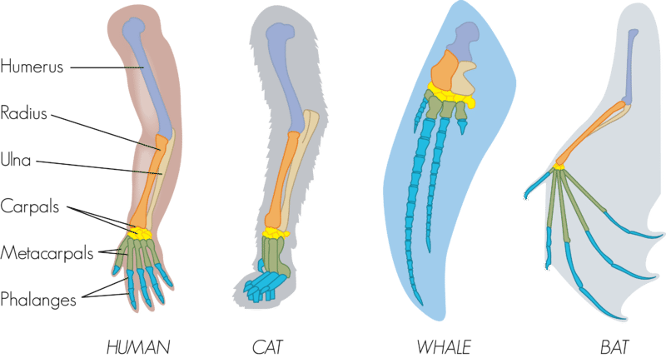
Evidence #3: Comparative Anatomy
Homologous structures: These are structures that have different uses but develop from the same embryonic tissue.
This means that the have the same parts but they do different things.

Slide 7
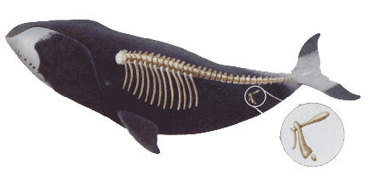
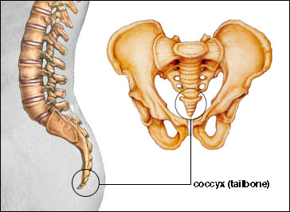
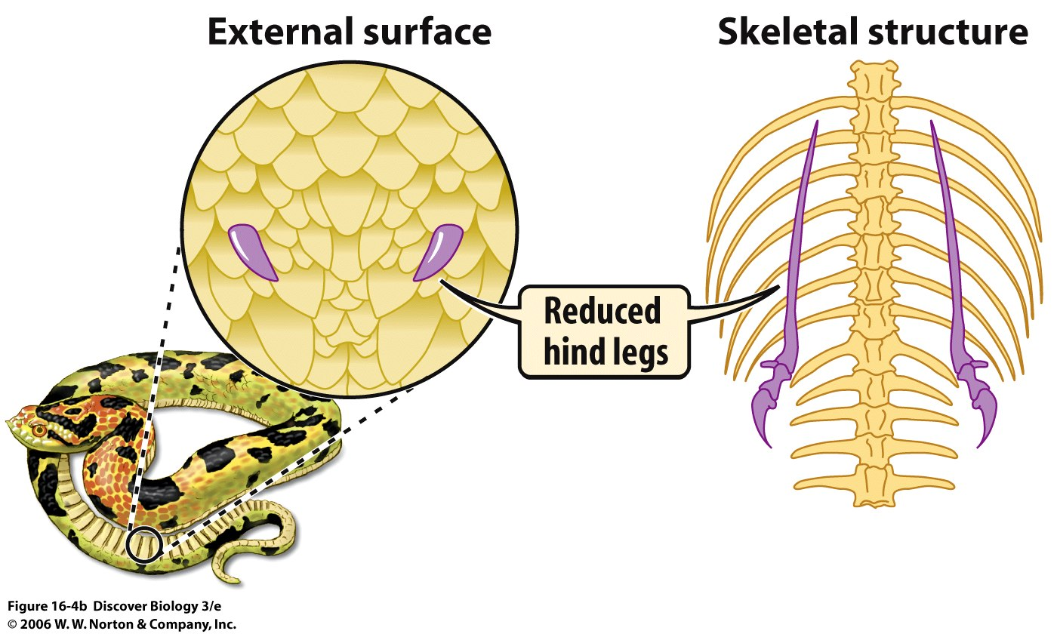
Vestigial Structures: These are structures that had purpose but are no longer used.
This means that we may have structure but we don’t use them anymore.

Slide 8
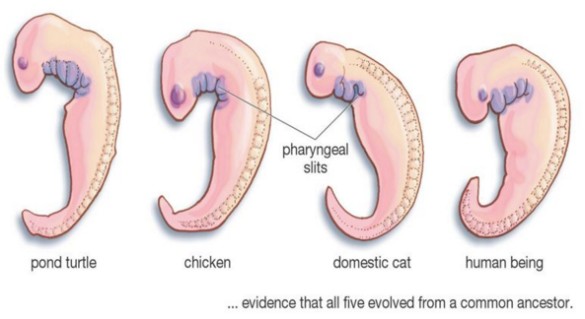
Evidence #4: Similarities in early
development
The early stages (aka: embryonic stages) of development in many animals are extremely similar.

Slide 9
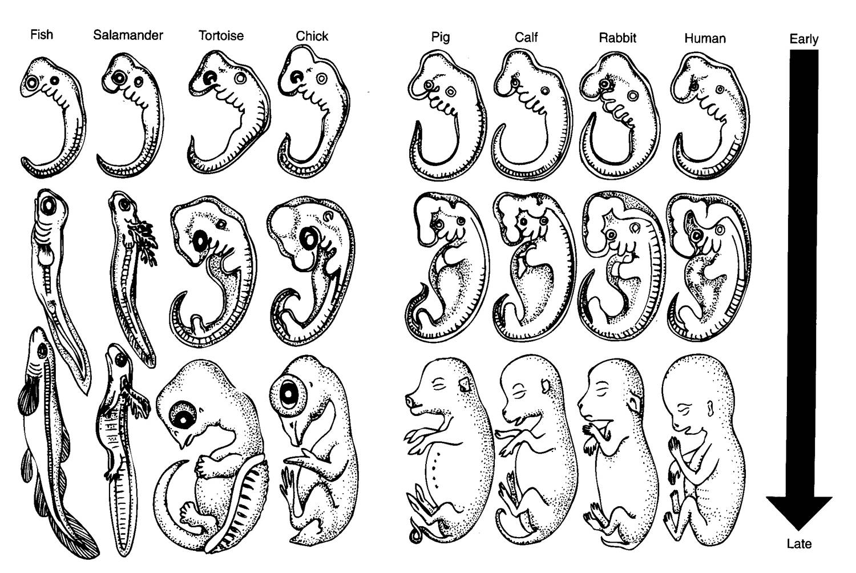

Slide 10
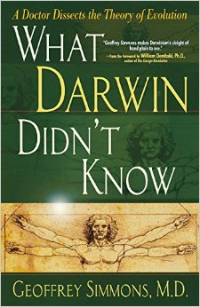
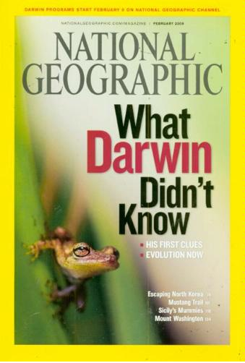
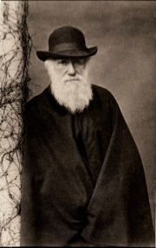
What Darwin Never Knew

Slide 11
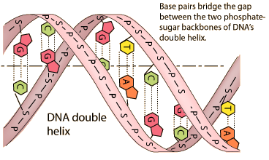
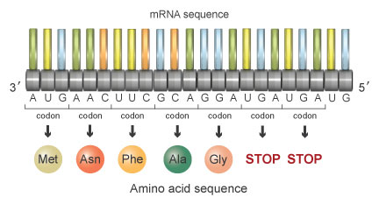
Biochemistry as Evidence of Natural Selection
Nitrogenous base sequences in DNA
Amino Acids sequences for common proteins

Slide 12
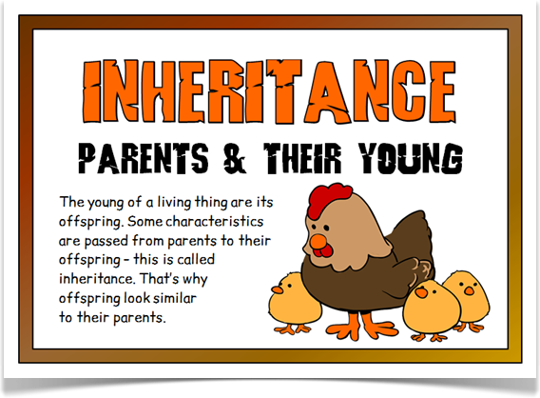
Genes and Variation
Darwin’s theory of evolution by natural selection explained how life on Earth changed over time.
What Darwin didn’t know was how heritable traits got passed down through each generation.

Slide 13
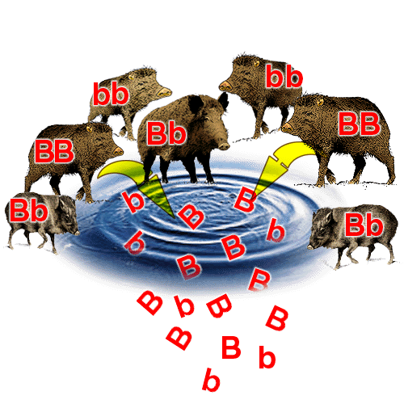
Genetics supports Darwin’s ideas
In genetic terms, evolution is any change in the relative frequency of alleles in a population.
A gene pool is all the genes and their alleles in a population.

Slide 14
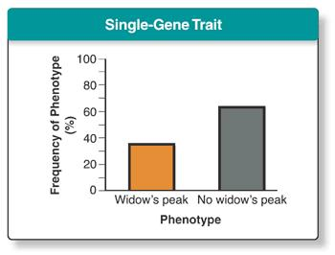
Evolution as Genetic Change
Natural selection can lead to changes in allele frequencies which will lead to evolution.
With single gene traits mate selection can increase or decrease relative frequencies of an allele.

