Slide 1
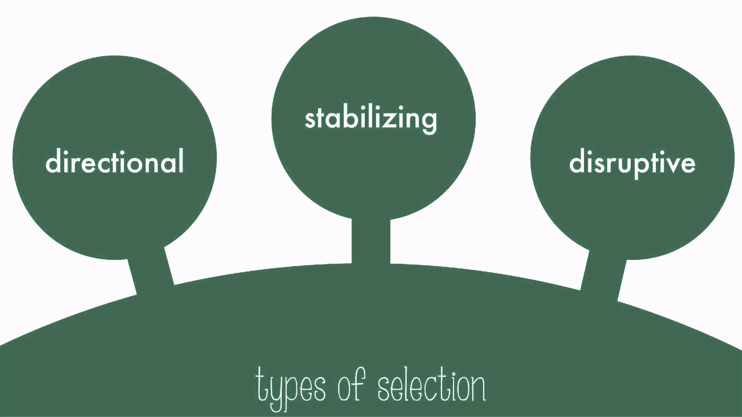
Modes of Natural Selection

Slide 2
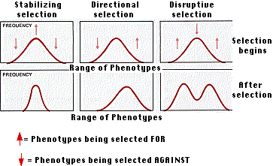
With polygenic traits natural selection is more complex and can occur in one of three different ways.

Slide 3
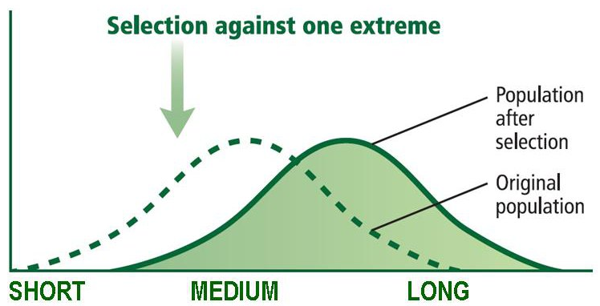
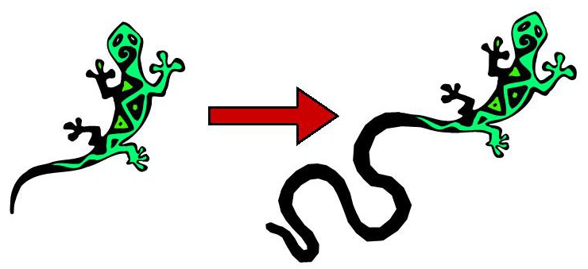
Directional Selection

Slide 4
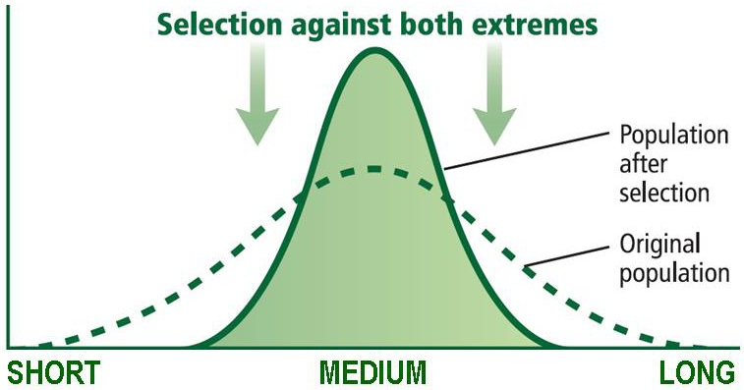
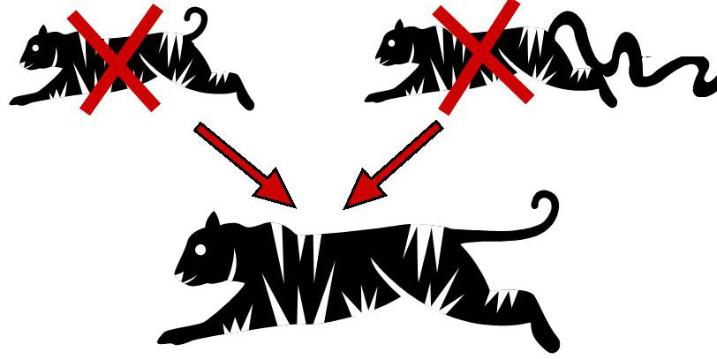
Stabilizing Selection

Slide 5
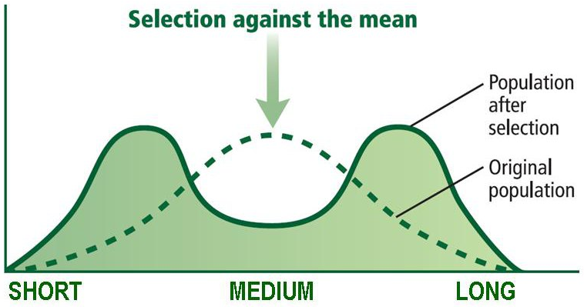
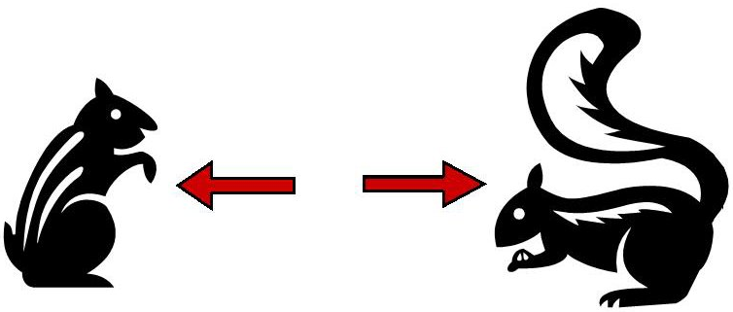
Disruptive Selection

Slide 6
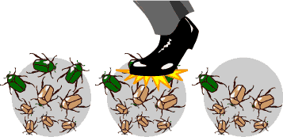
Genetic Drift
This occurs when individuals with a specific allele leave more descendants than other individuals, just by chance.

Slide 7
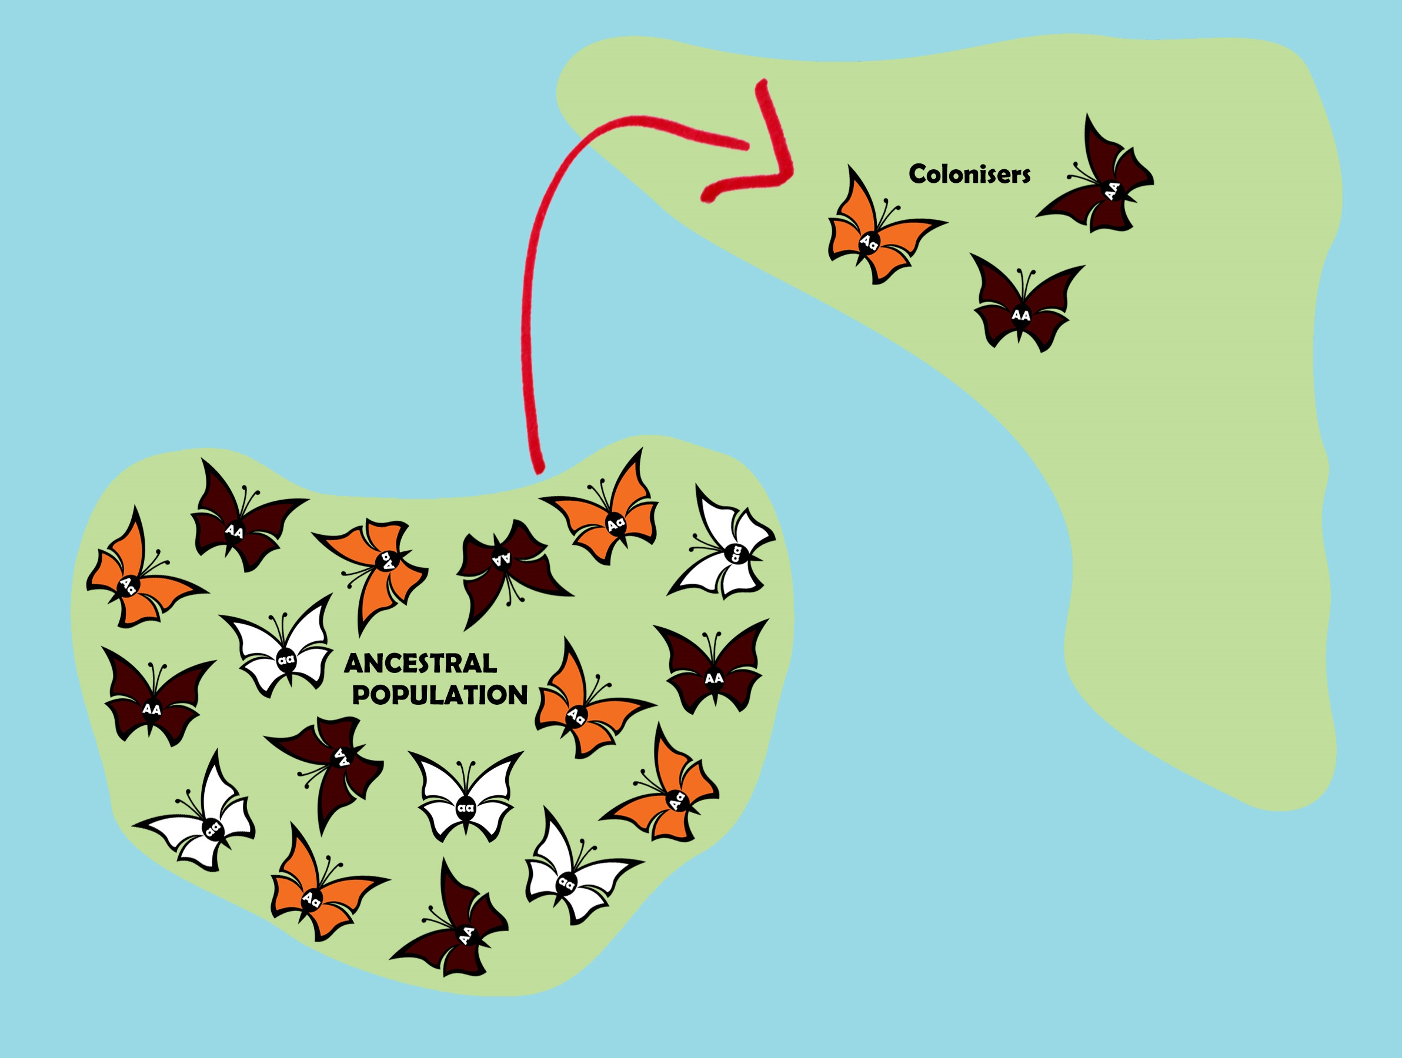
Founder Effect
Genetic drift that occurs when a small group of individuals leaves the main population and moves into a new habitat.

Slide 8
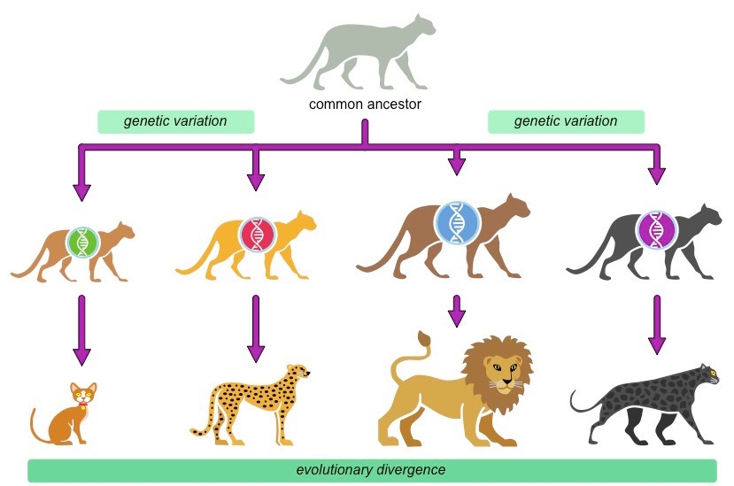
The Process of Speciation

Slide 9
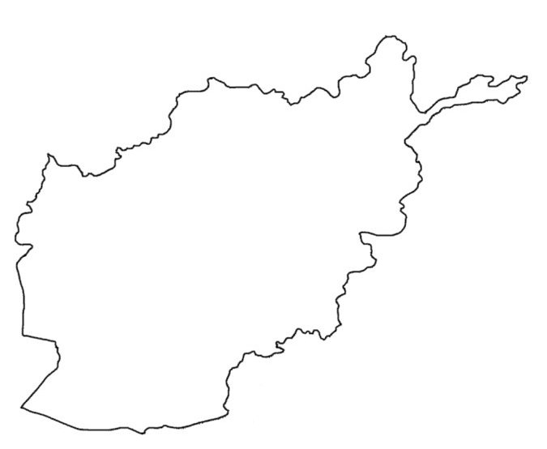
Speciation: is the formation of new species.
In order for one species to become two new species, the gene pools of two populations must be separated.
Jumpers and Gathers

Slide 10
When members of two populations can no longer interbreed and produce fertile offspring the are known as reproductive isolation.
There are three forms of reproductive isolation.
Behavioral Isolation
Populations develops different mating rituals
Geographic Isolation
Barriers separate populations so no mating can occur
Temporal Isolation
Occur when populations reproduce at different times

Slide 11
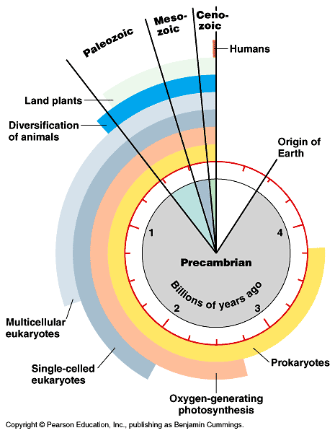
THE HISTORY OF LIFE

Slide 12
This is the leading explanation about how the universe began.
Currently believed to be 13.8 billion yrs old.
Started as a small singularity and then exploded outward

Slide 13
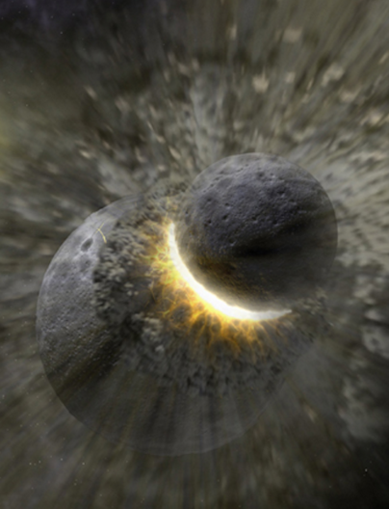
Earth is about 4.6 billion years old
At first the Earth was extremely hot
The early atmosphere probably consisted of:
Hydrogen cyanide, Carbon dioxide, Carbon monoxide, Nitrogen, Hydrogen sulfide and Methane
No liquid water present until the Earth was approximately 1 billion years old.

Slide 14
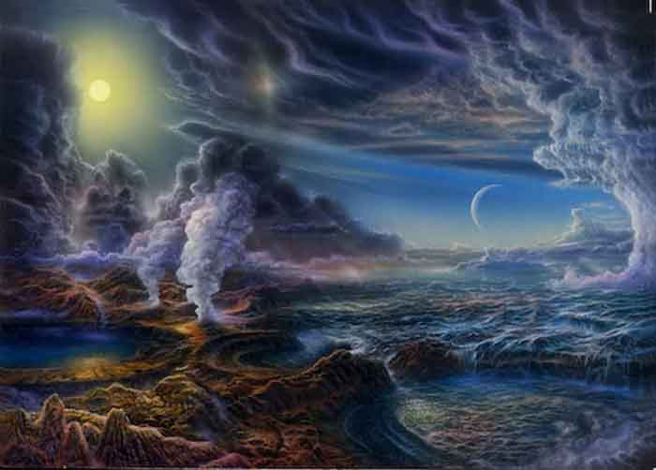
Earth’s Earliest Self-Portrait

Slide 15
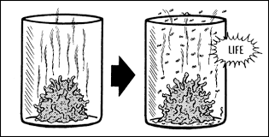
Spontaneous Generation
Spontaneous: to happen without cause or reason
Generation: to make or initial creation

Slide 16
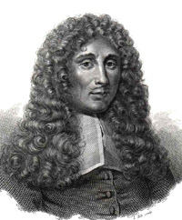
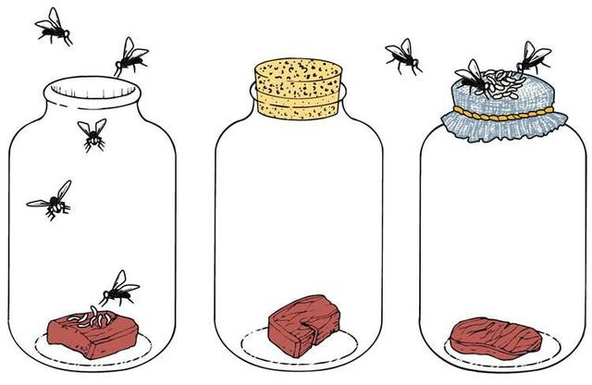
Spontaneous Scientists
Francesco Redi: An Italian scientist that speculated that vermin such as insects, worms and frogs do not arise spontaneously.
Redi set up a series of flasks containing meats.
Only flasks which allowed adult flies in and out contained maggots.

Slide 17
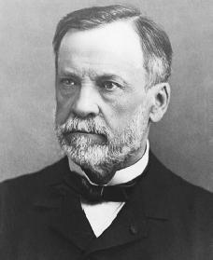
Spontaneous Scientists
Louis Pasteur: A French scientist who created vaccines for rabies but also designed an experiment in 1859 that disproved spontaneous generation.
Pasteur expanded upon the works of Redi

Slide 18
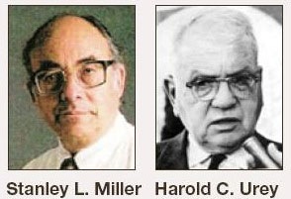
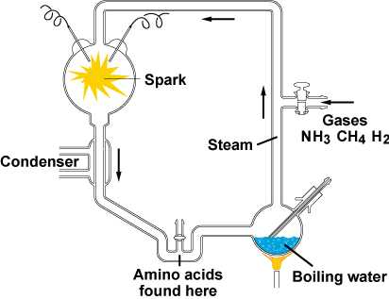
Spontaneous Scientists
Miller & Urey: American scientists that expanded the work of Alexander Oparin by creating a chemical experiment called the Miller-Urey Experiment.
The experiment confirmed Alexander Oparin's and J. B. S. Haldane's hypothesis that the conditions on primitive Earth supported chemical reactions that could create more complex organic compounds from simpler inorganic molecules.

Slide 19
Heterotroph Hypothesis

Slide 20
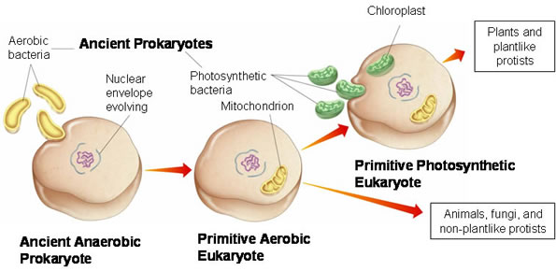
Endosymbiosis

