Slide 1
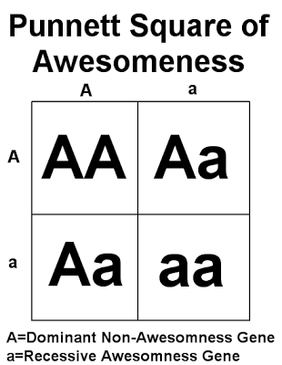
April 9th Genetics
NEW SEATING CHART ON STATION #7
If you were absent before break make sure to hand in your missing assignments.
What was the highlight of your spring break?
Give an example of incomplete dominance.
Define epigenetics.
Define passive transport and list three examples.

Slide 2
Informal Punnett Square Quiz
When finished raise your hand and I will give you the Genetics packet.
Complete page one. You will need a Chromebook.

Slide 3
Karyotypes
Three different colored writing utensils

Slide 4
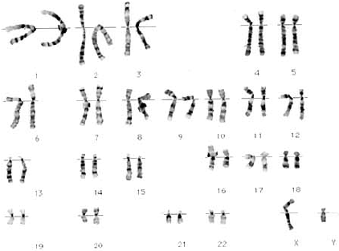
Normal Human Male Karyotype: 46,XY

Slide 5
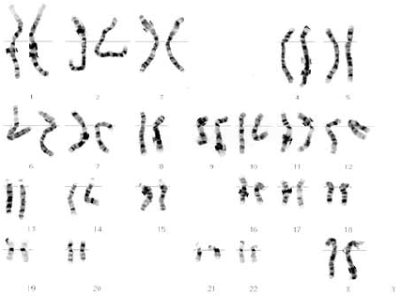
Normal Human Female Karyotype: 46,XX

Slide 6
What are abnormalities?
Sometimes, during meiosis, things go wrong.
The most common error is nondisjunction, which means “not coming apart”.
If nondisjunction occurs , abnormal numbers of chromosomes may find their way into gametes, and a disorder of chromosome numbers may result.

Slide 8
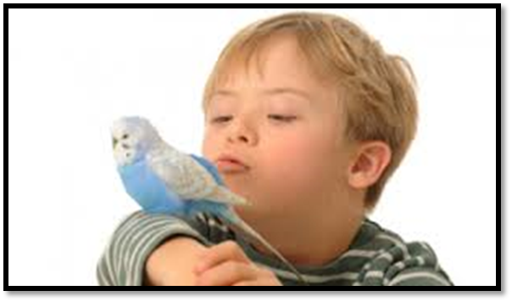
Autosomal Chromosome Disorders
Two copies of an autosomal chromosome fail to separate during meiosis, an individual may be born with THREE copies of a chromosome.
This is known as a “Trisomy”
Trisomy 13, Trisomy 18, Trisomy 21.
Notes:
13: Patau Syndrome causes severe intellectual disability and physical defects. Most infants don’t live past the first week of their life
18: Edwards syndrome: low birth weight, small abnormally sharpened head, and birth defects in organs that is often life threatening.

Slide 9
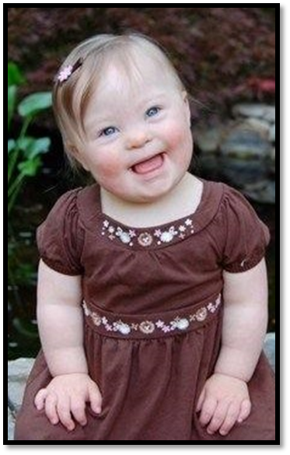
Down Syndrome
Most common, Trisomy 21 (down syndrome)
1 in 700 babies born in U.S. with Trisomy 21.
Distinct facial appearance, intellectual disability, developmental delays
Increased susceptibility to many diseases and a higher frequency of other birth defects.
Notes:
Low muscle tone.
Single deep crease across center of palm.
Looseness of joints.
Small skin folds at the inner corners of the eyes.
Excessive space between first and second toe.
In addition, down syndrome always involves some degree of mental retardation, from mild to severe. In most cases, the mental retardation is mild to moderate.

Slide 10
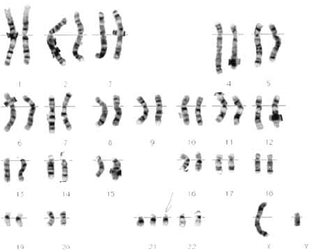
Male: 47, XY, +21
Female: 47, XX, +21

Slide 11
Sex Chromosome Disorders
Turner’s Syndrome (nondisjunction)
Female inherits only one X chromosome
Karyotype: 45, X
Women are sterile, sex organs do not develop at puberty.
Klinefelter’s syndrome (nondisjunction)
Males receive an extra X chromosome
Karyotype: 47, XXY
The extra X chromosome interferes with meiosis and prevents individual from reproducing.

Slide 12
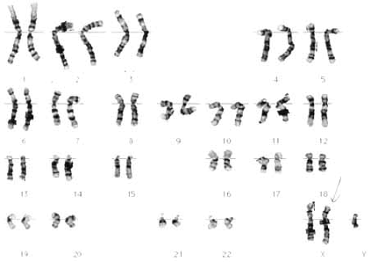
Klinefelter’s Syndrome, 47 XXY

Slide 13
How do we obtain a karyotype?
https://www.youtube.com/watch?v=Ga7nqCk8ao8

Slide 14
#1 Identify Sex and Disorder (if any)

Slide 15
#2

Slide 16
#3

Slide 17
#4

Slide 18
#5

Slide 19
#6

Slide 20
Get It 1-4 due tomorrow If finished begin vocabulary

Slide 21
Mutation Type: Chromosomal Mutations
Original Chromosome – ABCDEFGHIJ
(letter = gene)
Deletion → ABCEFGHIJ
**One or more genes is/are deleted

Slide 22
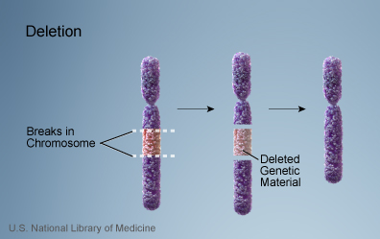
Chromosomal Deletion

Slide 23
Mutation Type: Chromosomal Mutations
Original Chromosome – ABCDEFGHIJ
Inversion → ABCFEDGHIJ
***Set of genes are flipped/inverted

Slide 24
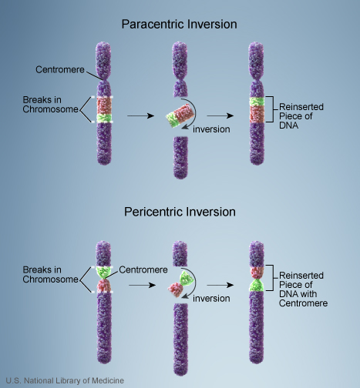
Chromosomal Inversion

Slide 25
Mutation Type: Chromosomal Mutations
Original Chromosome – ABCDEFGHIJ
Insertion → ABCDCDEFGHIJ
***One or more genes are re-inserted & appear more than one time
***Inserted genes may come from
any chromosome

Slide 26
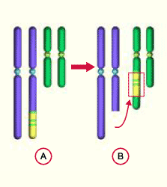
Chromosomal Insertion

Slide 27
Mutation Type: Chromosomal Mutations
Original Chromosome – ABCDEFGHIJ
Translocation → ABCDHIJ &
ABCDEFGHIJEFG
**One or more genes are moved from one chromosome to another chromosome; they exchange places

Slide 28
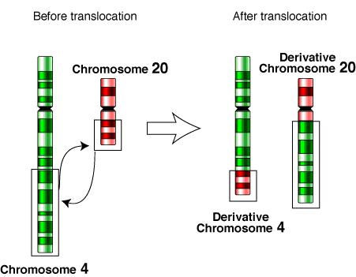
Chromosomal Translocation

