Slide 1
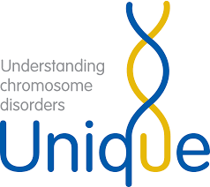

April 10th Genetics
What is a karyotype?
What is the chromosomal abnormality for Downs Syndrome?
What is the chromosomal abnormality for Turners Syndrome?
Cross a hemophiliac male with a woman whose mother had hemophilia and father was normal.

Slide 2
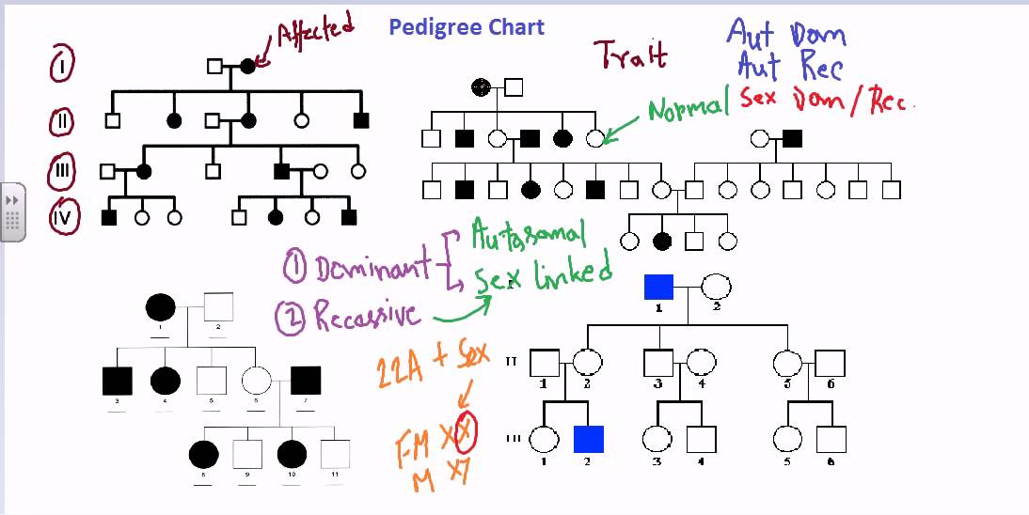
Pedigrees
A valuable tool for anyone working in the field of genetics.
Used to show relationships in families and resemble a family tree.

Slide 3
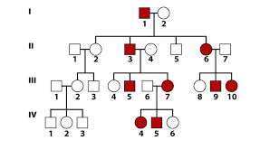
Circles represent females
Squares represent males.
Generations are represented by roman numerals on the LEFT side of the pedigree.
Death is represented by a slash through the symbol.

Slide 4
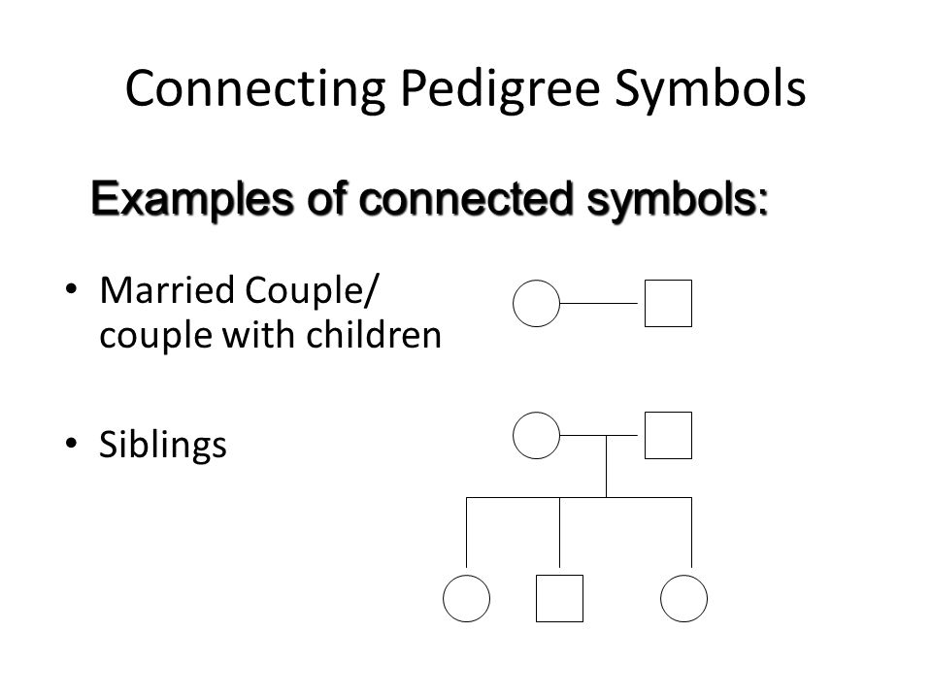
Lines that connect circles and squares horizontally represent that reproduction has occurred.
The further to the left an individual is the older they are. Who is oldest in this relationship?

Slide 5
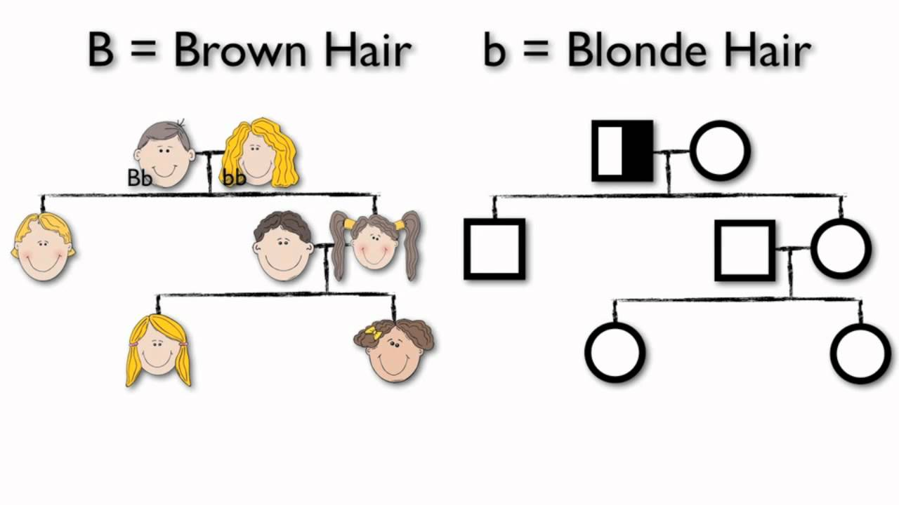
Any vertical lines that drop down from the center of the above horizontal line show the offspring of the parents.

Slide 6
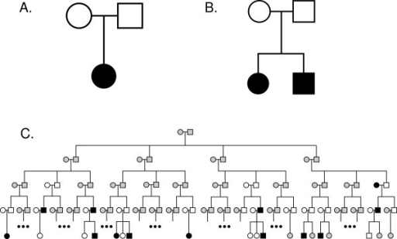
We can then mark offspring that exhibit or DO NOT exhibit certain characteristics, such as eye color.
The following pedigree shows family members with blue eye color.
Ex. Brown eyes (B) are dominant over blue eyes. We can deduct the genotypes of some of the family members. Try to predict what the genotypes of the above family are for eye color.

Slide 7
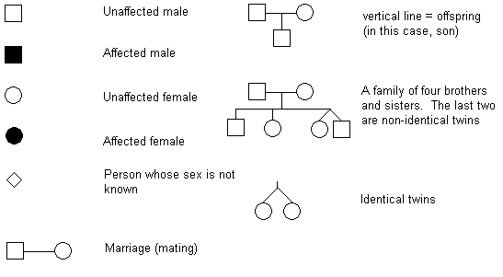
Common Pedigree Symbols

Slide 8
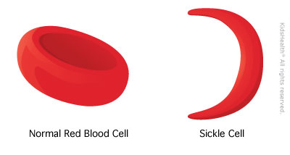
Now let’s discuss the story of sickle‐cell anemia. In Africa, there is a high incidence of malaria. Malaria is caused by a parasite that is transmitted by mosquitoes. The parasite feeds on the hemoglobin protein in red blood cells. If there is mutated strain of hemoglobin in the red blood cells, the parasite starves to death and dies. The picture on the right shows a sickle red blood cell and the picture on the left show a normal red blood cell.

Slide 9
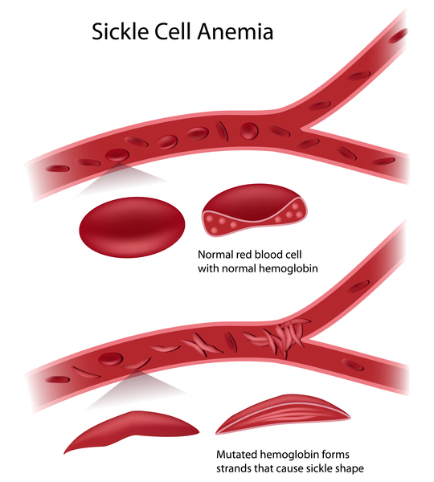
Persons who are homozygous for normal red blood cells easily die from malaria. Persons who are homozygous for mutated red blood cells usually do not die from malaria, but could die from complications resulting from their odd shaped red blood cells (sickle‐cell anemia). Individuals who are heterozygous also usually do not die from malaria and are spared from the awful complications of sickle‐cell anemia.

Slide 10
Using the following information, design a pedigree chart and designate which of the family members is homozygous for normal hemoglobin (HH), heterozygous (Hh), and homozygous recessive (hh).
~Mom‐survived malaria
~Dad‐ died from complications from sickle‐cell anemia at age 42.
~Son #1‐ survived malaria
~Son #2‐ Survived malaria, has sickle‐cell anemia
~Daughter #1‐ survived malaria

Slide 11
MAKE A KEY:

Slide 13
Questions:
If the daughter marries a man who has normal hemoglobin (HH) in his red blood cells, what is the probability that their children will have sickle-cell anemia?

Slide 14
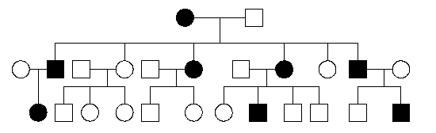
Autosomal Dominant
A dominant condition is transmitted in unbroken descent from each generation to the next.
There would be no carriers.
Any individual that is “filled in” would be homozygous dominant or heterozygous and would exhibit the dominant trait.
Could be NN or ___
Homozygous recessive genotype (___)

Slide 15
Autosomal Recessive
A recessive trait will only manifest itself when both alleles are present in an individual.
(Ex. nn)
Offspring can have the trait while neither parent exhibits the trait.
Carrier- Has an allele for a recessive trait but does not show the phenotype.

Slide 16
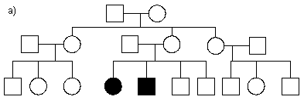
Autosomal Recessive
An autosomal recessive condition may be transmitted through a long line of carriers before, by ill chance two carriers mate. Then there will be a ___ chance that any child will be affected.
These must be ____
N
n
N
NN
Nn
n
Nn
nn

Slide 17
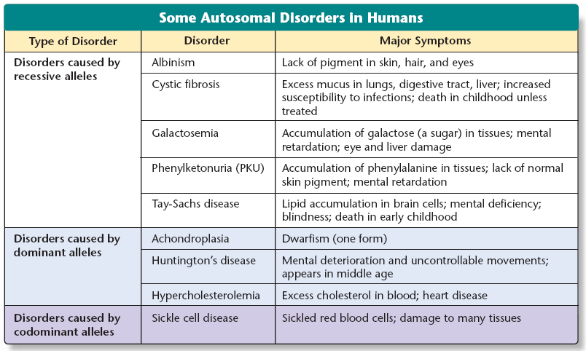

Slide 18
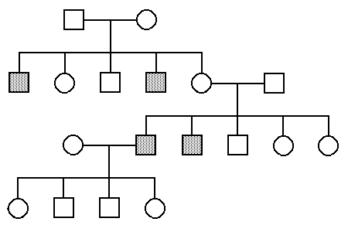
Sex-Linked Recessive Pedigree
Males only need one copy of the recessive allele, from the mother, to show the trait/disease
Occurs more frequently in males than in females

Slide 19
Make your own pedigree…
Left-handedness (h) is a recessive trait.
Bill and Mary have a son, Mike, and a daughter, Sue (youngest) that are right-handed. They also have a middle daughter, Marie that is a lefty. Sue gets married to John (righty) and has three children. Their oldest daughter, Sarah and their middle son, Joe are right handed. Yet their youngest son, Ryan is lefty.
REMEMBER: Label generations, individual names, and genotypes known.

Slide 21
Amoeba Sisters Pedigrees
Write six facts pertaining to the video to hand in when finished.
https://www.youtube.com/watch?v=Gd09V2AkZv4

Slide 22
Page 9 of Get It Together

Slide 23
The Turkie Family Pedigree
Work in pairs of two. This can be difficult. Let me know if you need help.

